Slide 1
Focus on physicians: the UK 2023 census of consultant physicians
Produced by the RCP Medical Workforce Unit on behalf of the Federation of Royal Colleges of Physicians of the UK

Slide 2
The number of physicians in the UK
24,863
consultant physicians on the GMC specialist register
22,253 make up our dataset on practising physicians (including locums and SAS doctors)
7,004 higher specialty trainees*
*data provided by the Joint Royal Colleges of Physicians Training Board

Slide 3
Who responded to the census survey?
The 2023 census survey was sent to 22,253 physicians
3,689 physicians responded
3,666 responses from practising NHS consultants
151 responses from SAS doctors*
*data on SAS doctor responses will be published separately

Slide 4
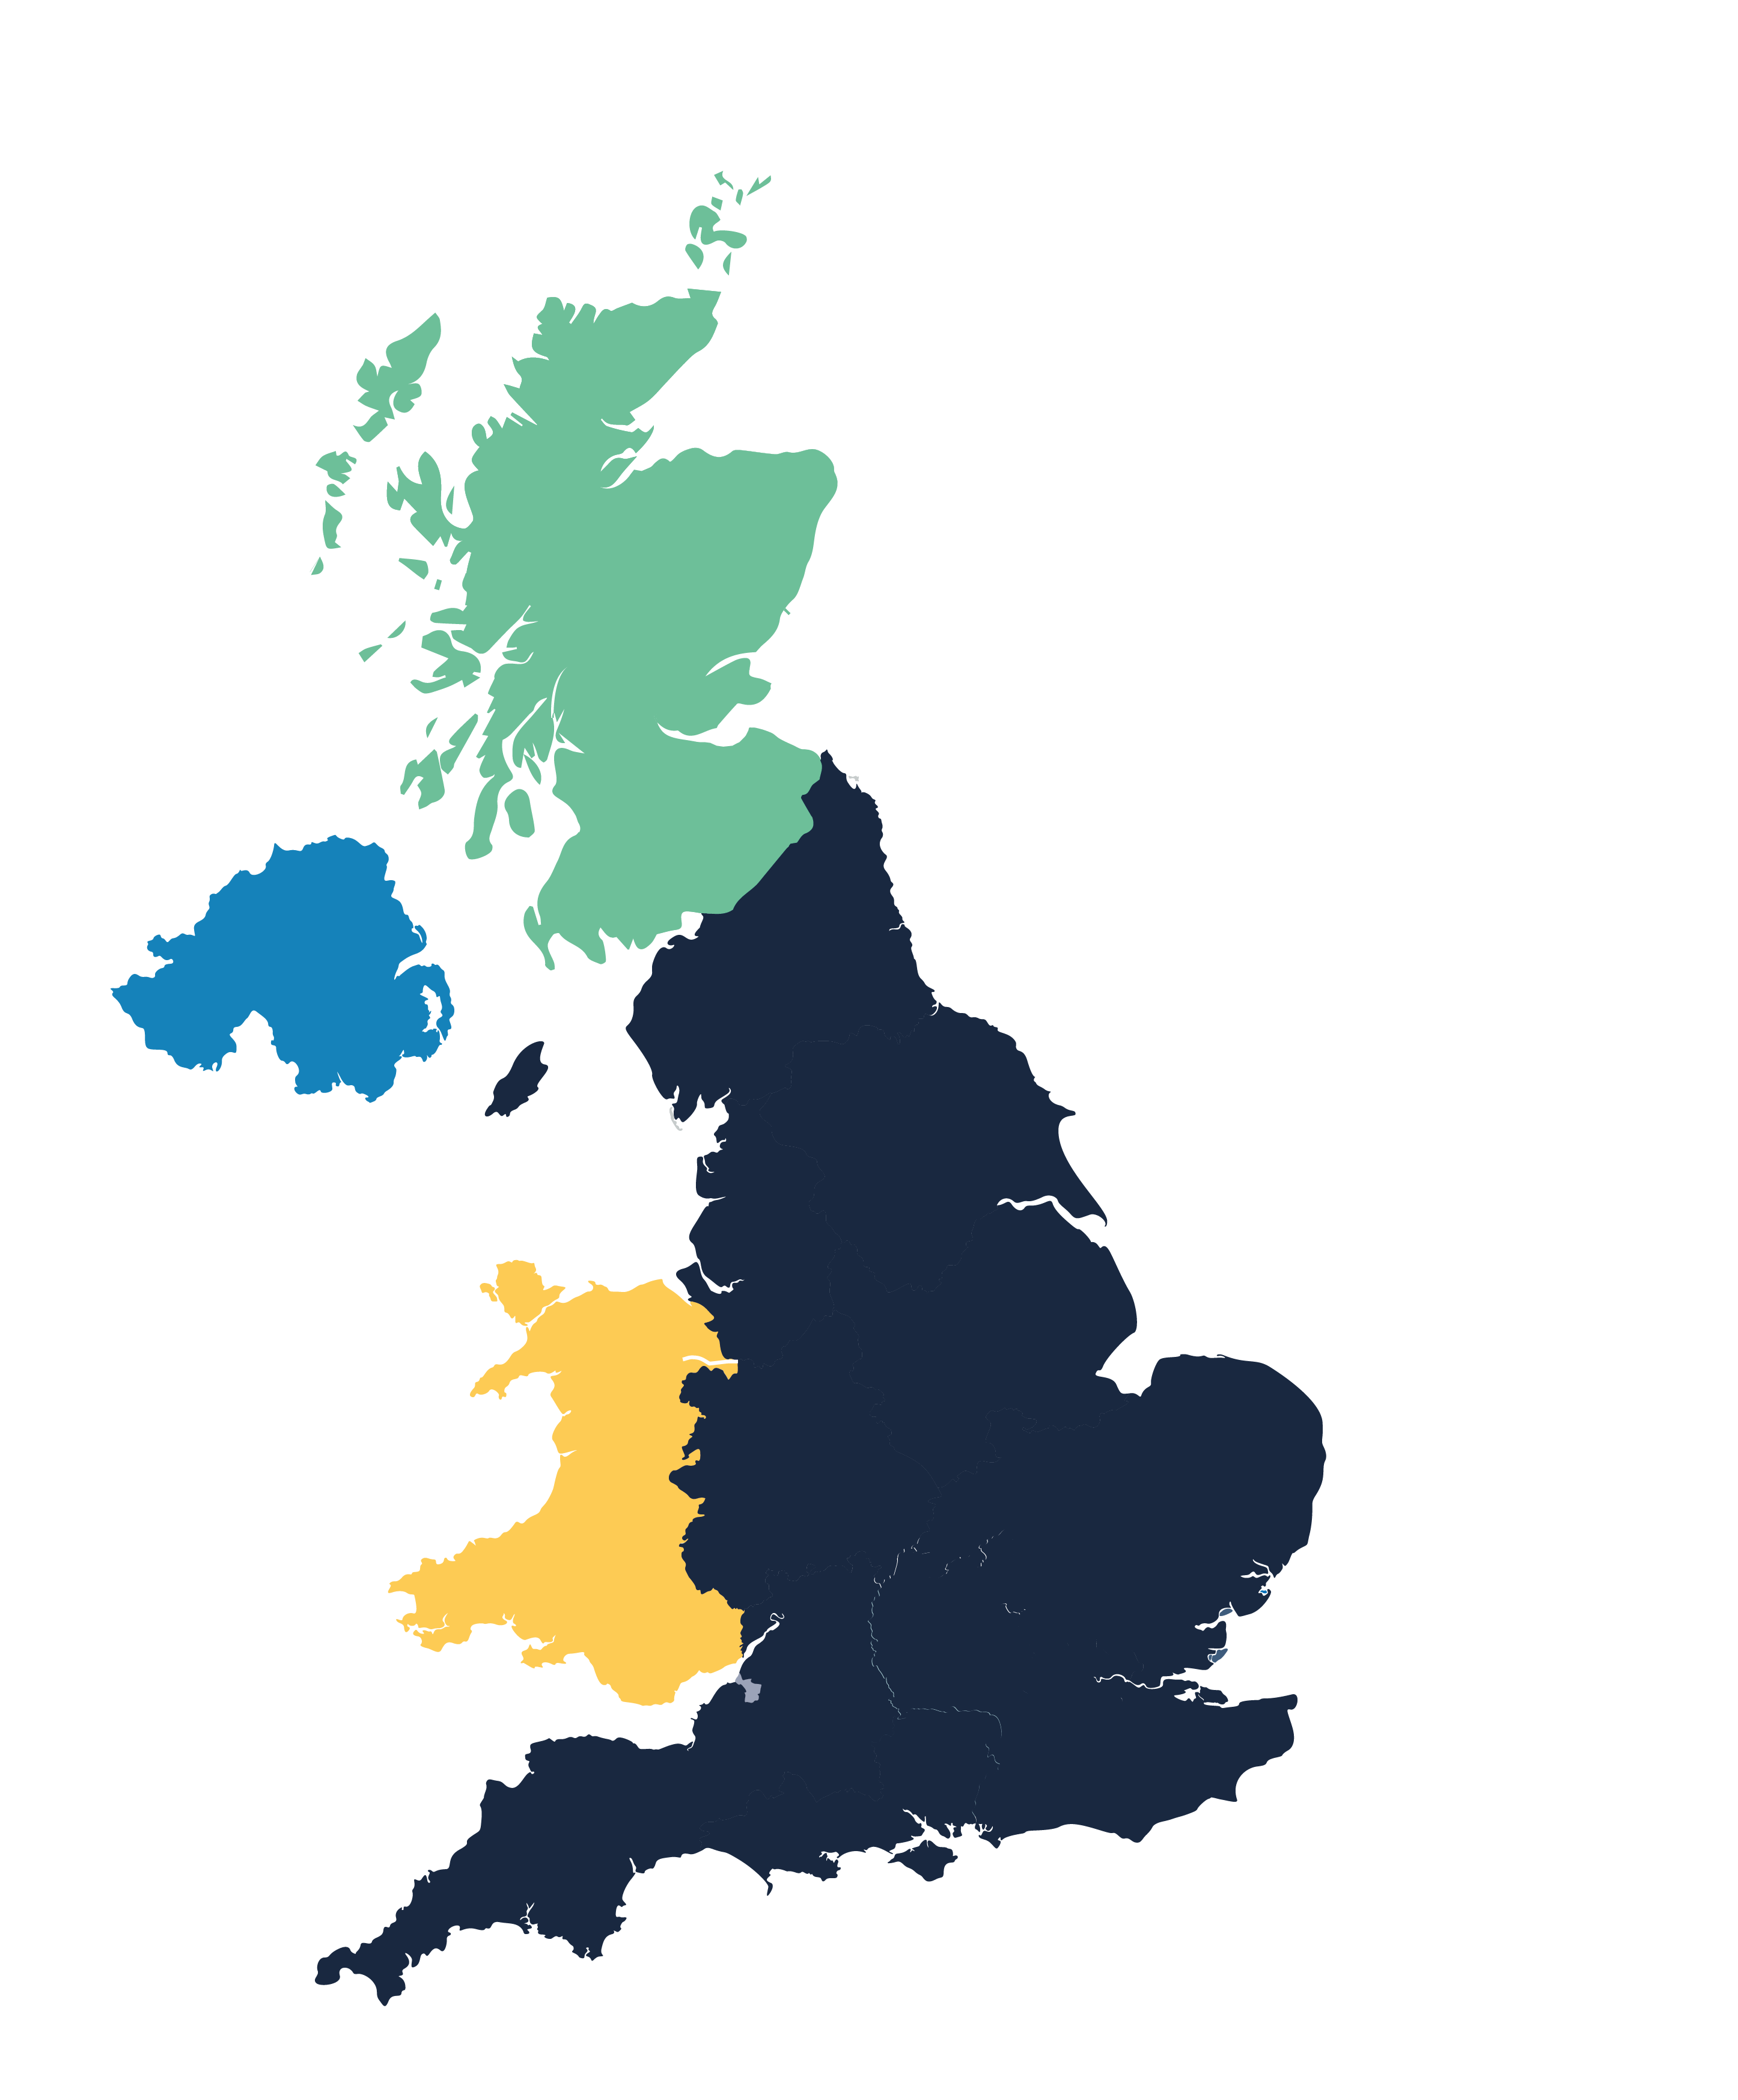
Consultant responses by country
Response rate for each nation
Scotland – 20%
367 of 1,842
Northern Ireland – 18%
110 of 598
England – 17%
3,067 of 18,468
Unknown
17
Wales – 14%
128 of 937

Slide 5
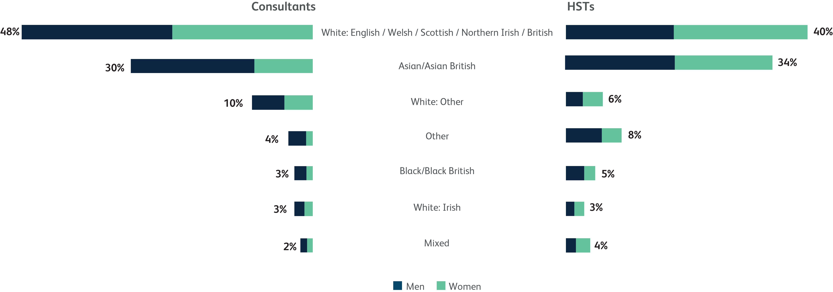
Ethnicity and sex of doctors in the UK
Consultants total = 19,650
Higher specialty trainees total = 7,004
Please note that ethnicity was unknown for 754 HSTs.

Slide 6
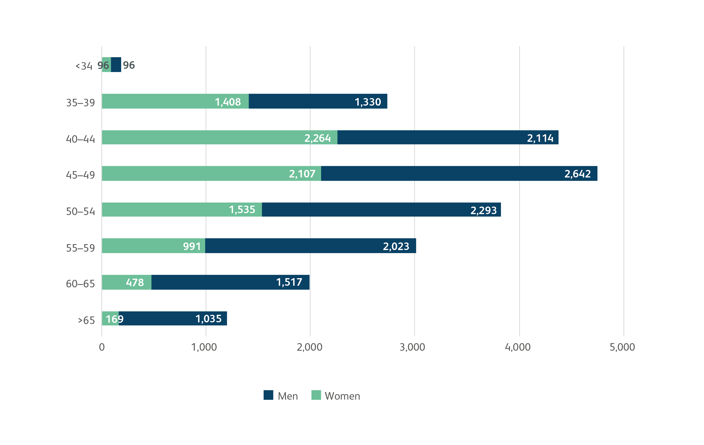
Number of consultants in each age group
Total consultants = 22,213 from our dataset NB: 115 consultants where age was unknown

Slide 7
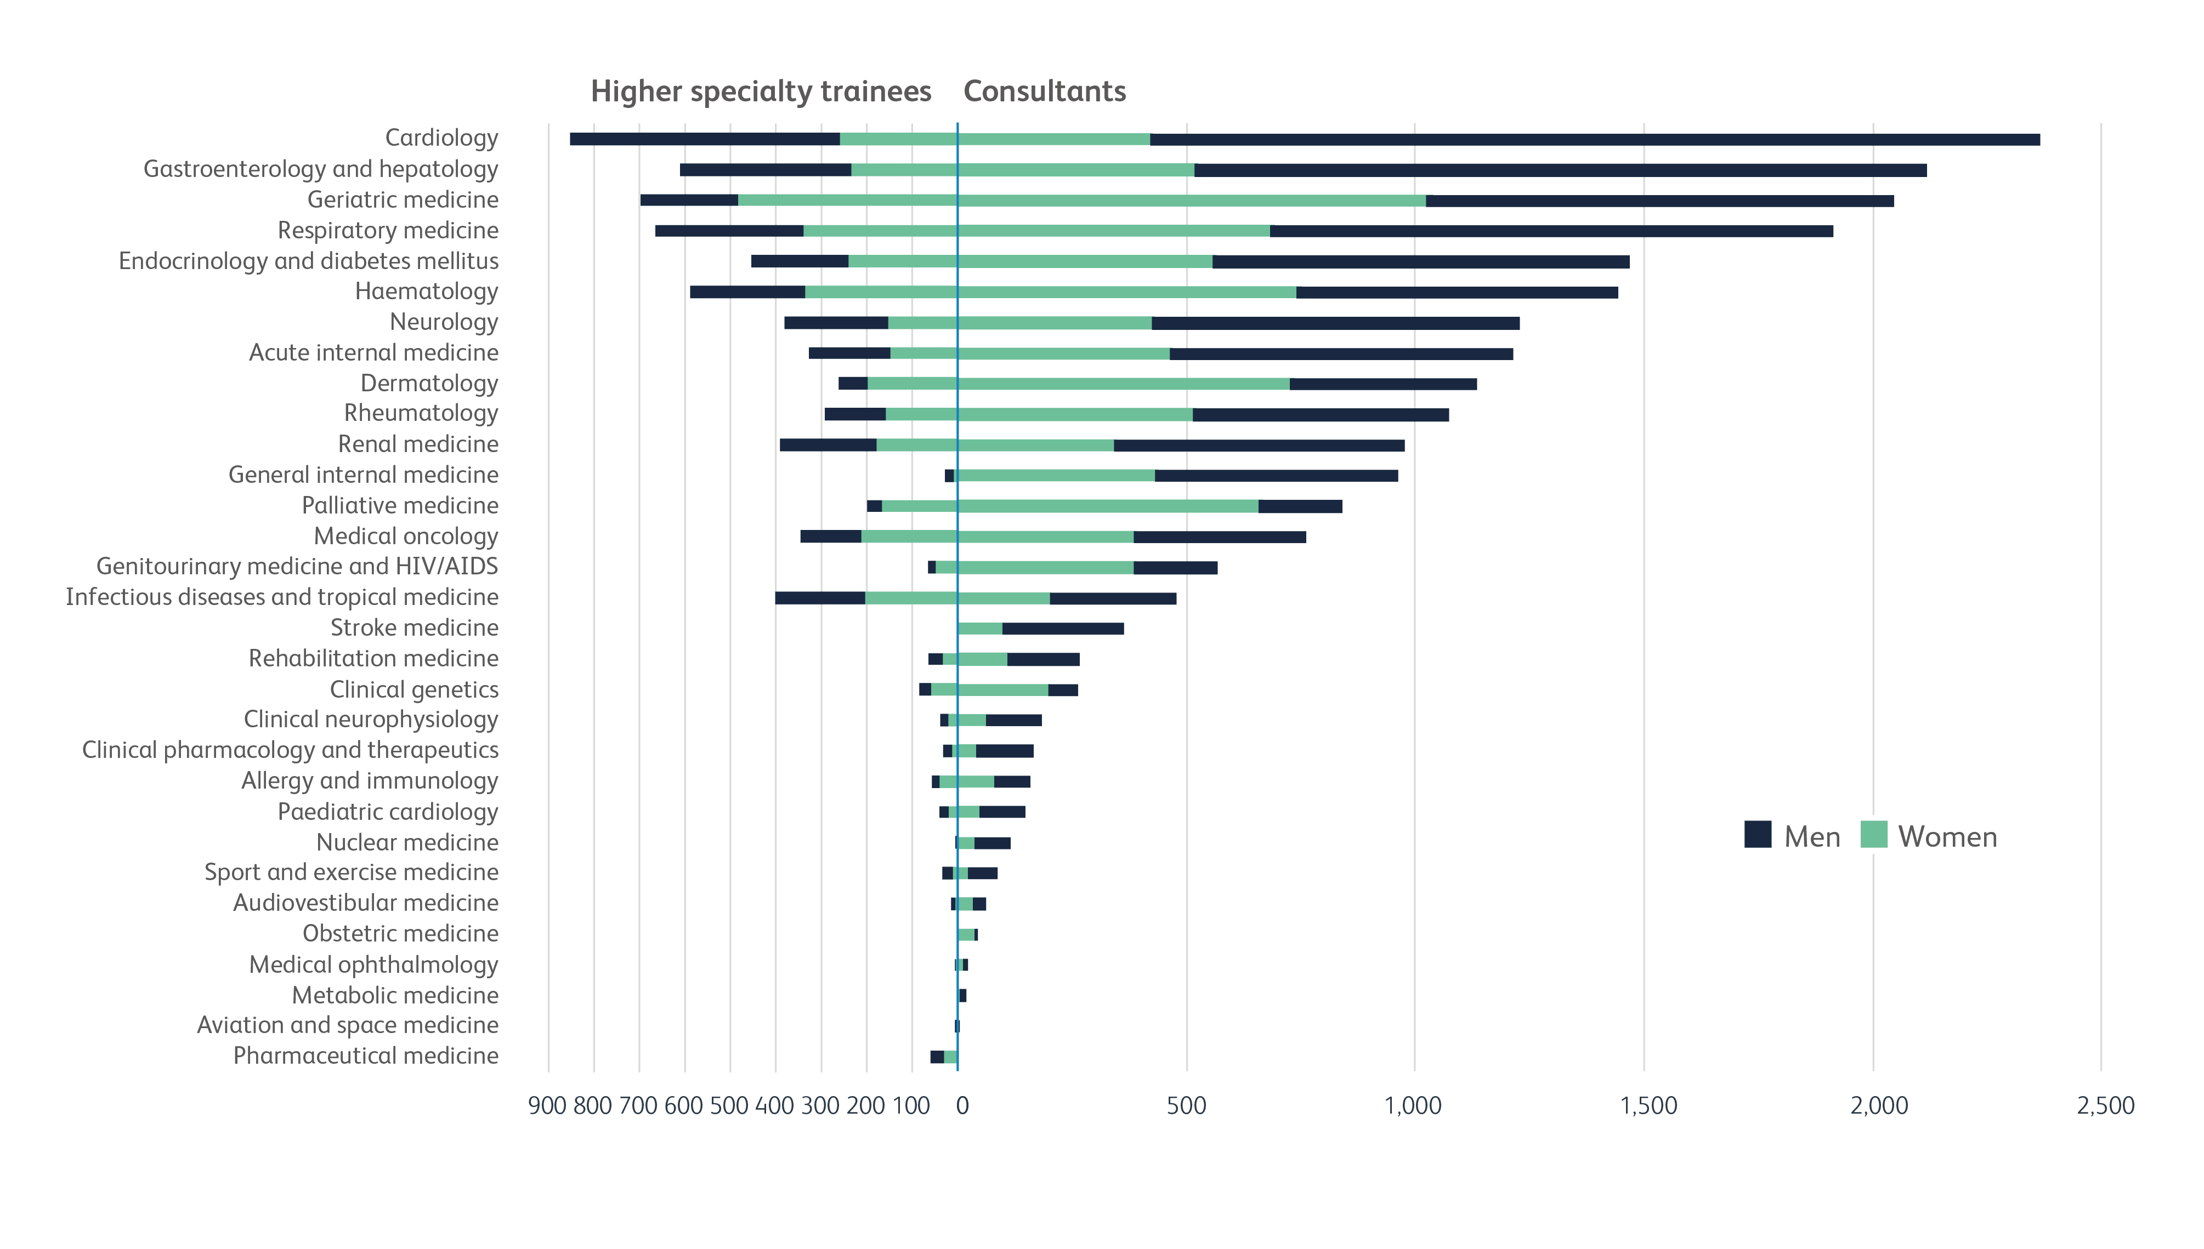
The number of physicians by specialty
Total consultants = 22,213 in our dataset; Total HSTs = 7,004 from JRCPTB database

Slide 8
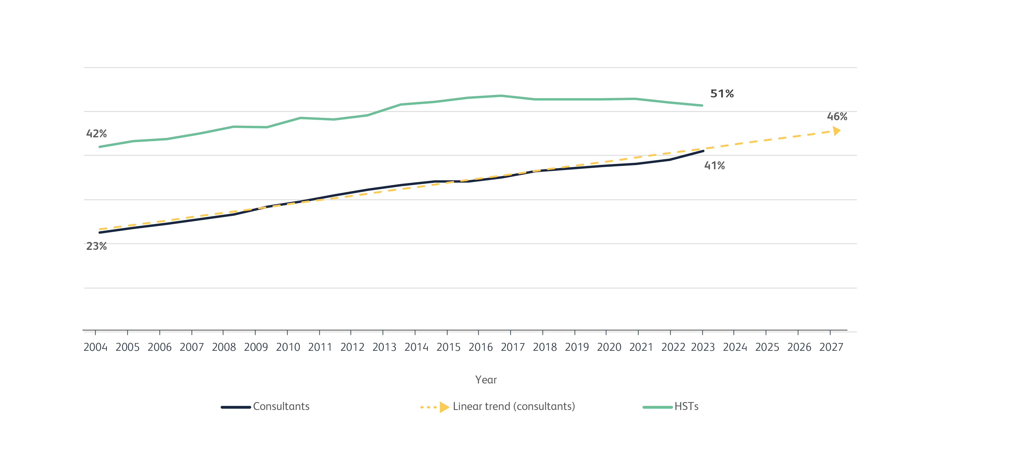
Women in the workforce over time
Total number of female consultants in our dataset = 9,104
Total number of female higher specialty trainees on JRCPTB database = 3,607

Slide 9
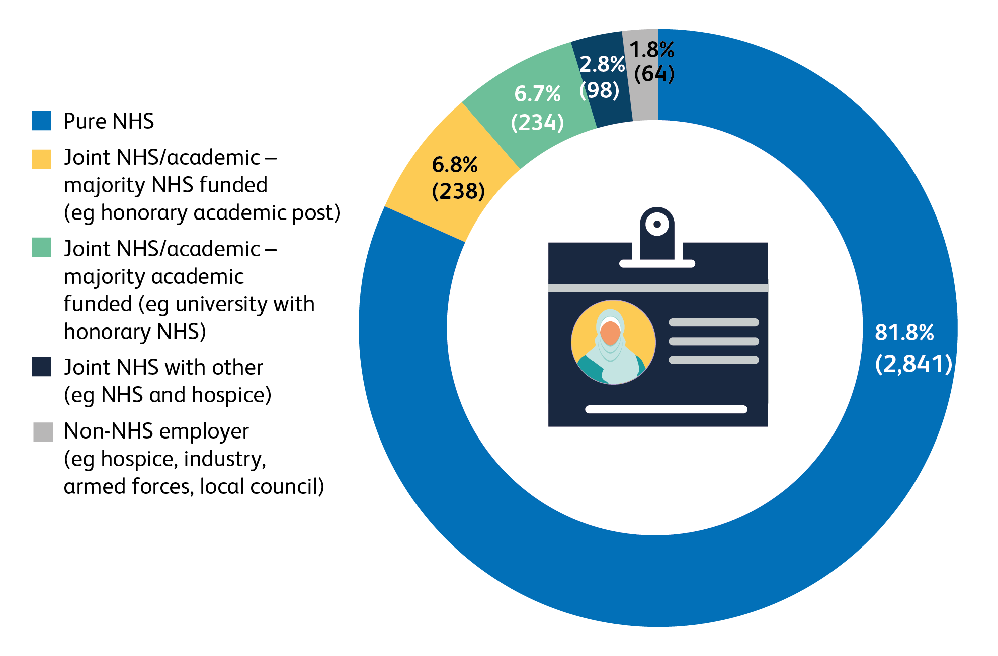
Who employs consultants?
Based on 3,475 consultant responses

Slide 10
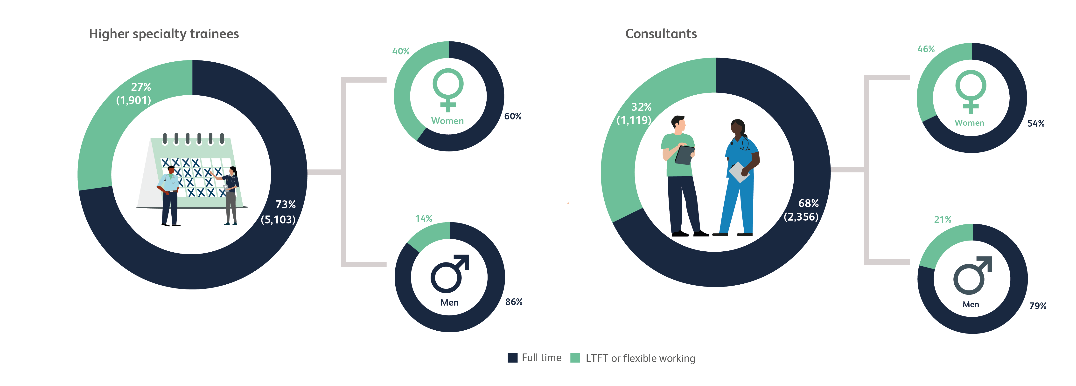
Full-time vs less-than-full-time and flexible working
7,004 higher specialty trainees from JRCPTB database
3,475 responses to survey sent to 22,253 physicians
15.6% response rate

Slide 11
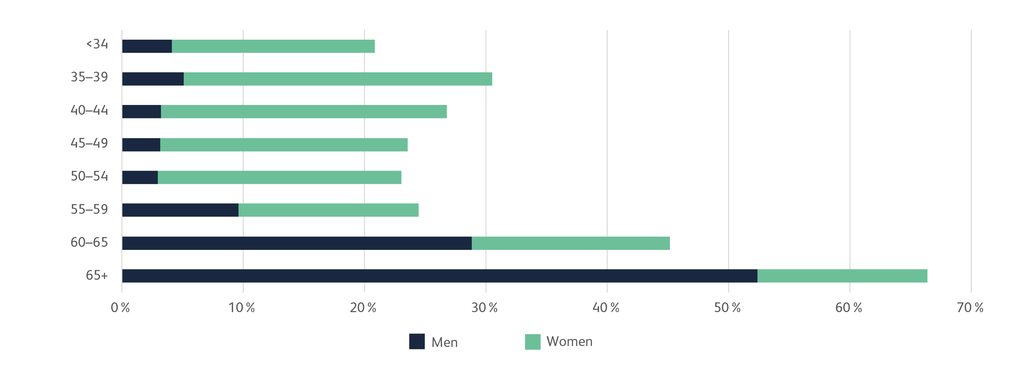
Proportion of consultants in each age bracket who work less than full time
Based on 3,475 consultant responses

Slide 12
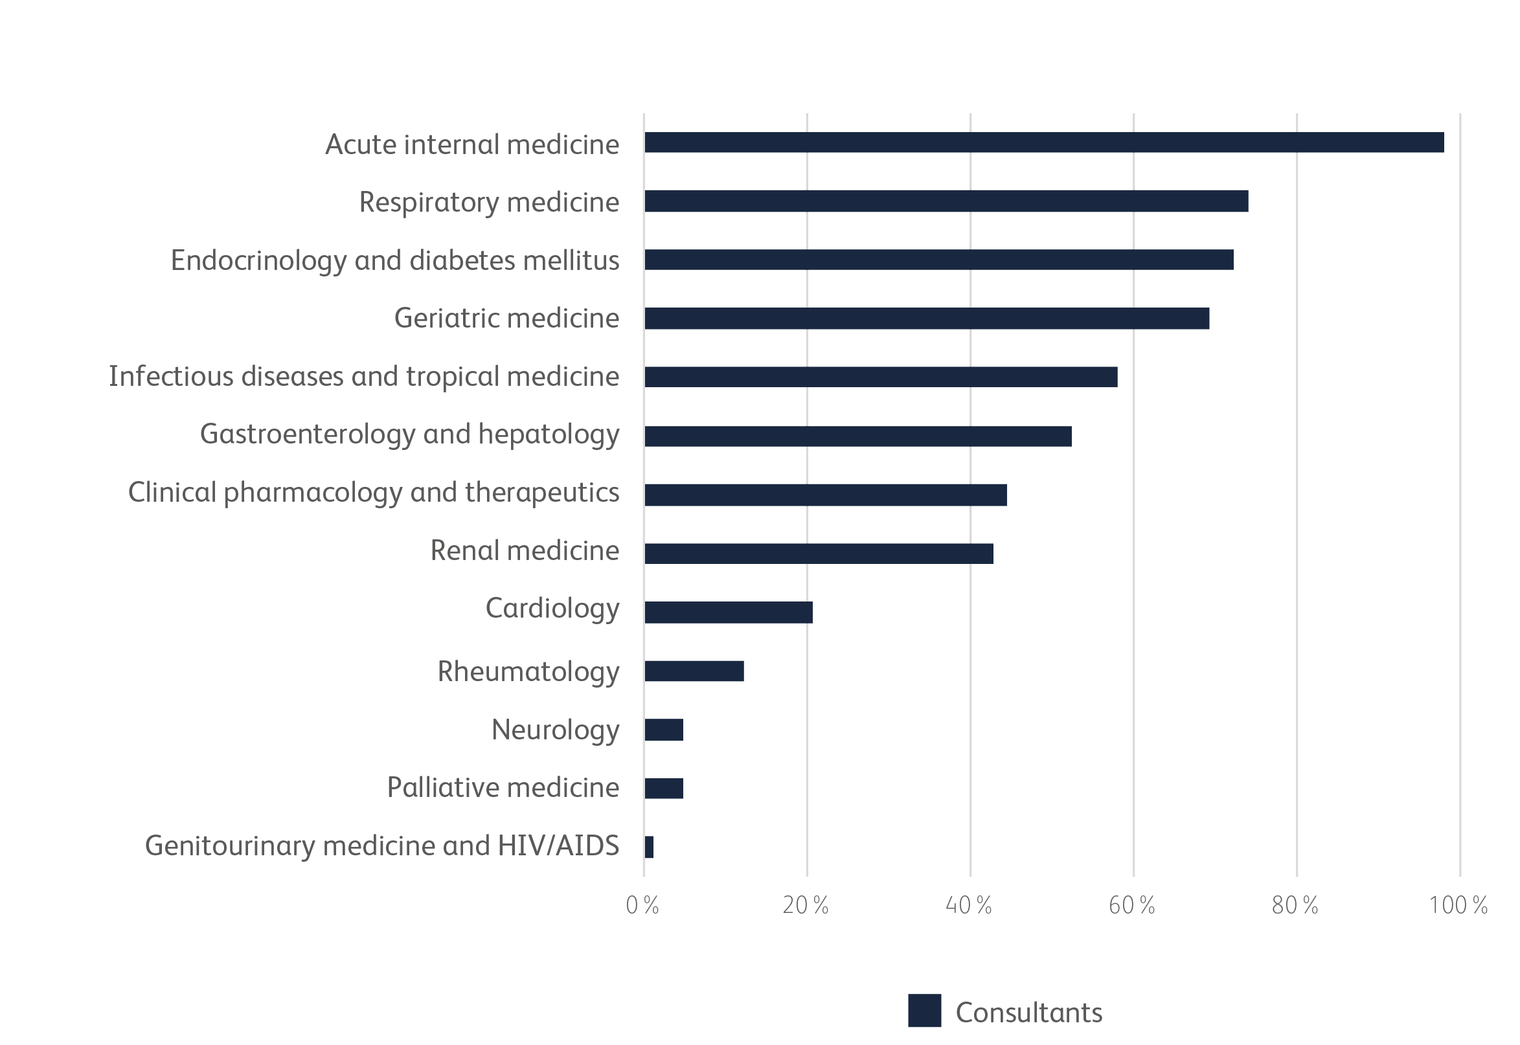
Do you see acute unselected admissions or look after general internal medicine patients?
Group 1 specialties
Based on 2,476 consultant responses for group 1 specialties

Slide 13
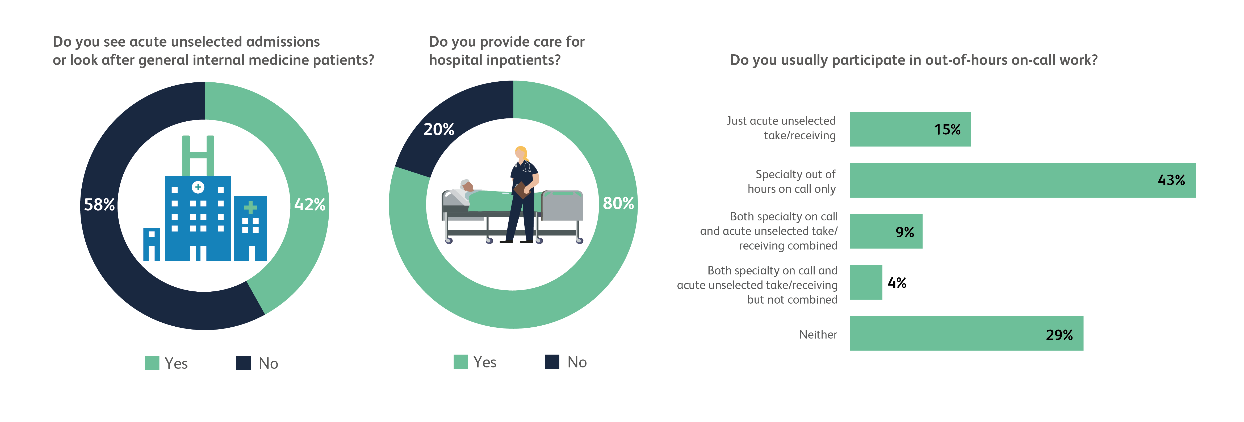
Unselected emergency admissions
Based on 3,513 consultant responses

Slide 14
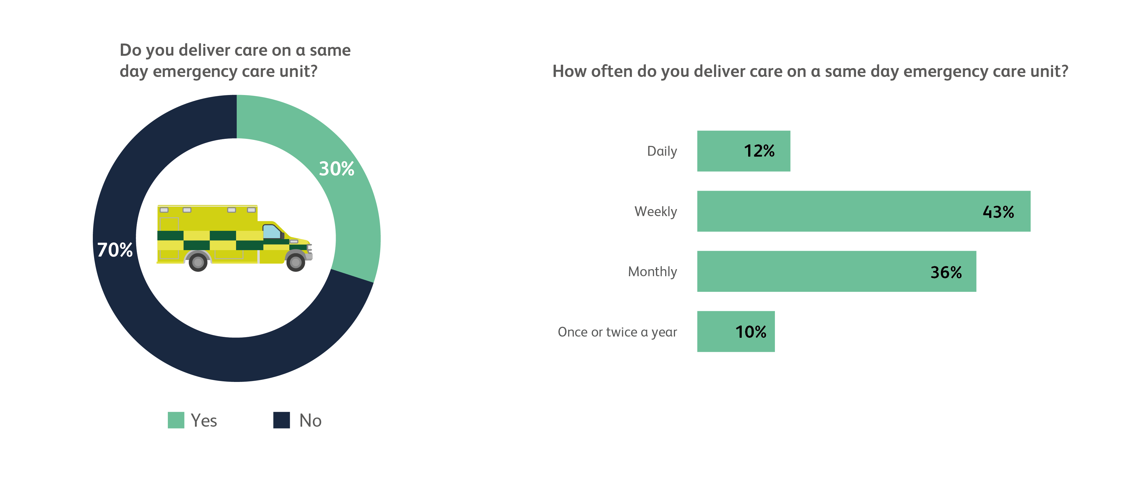
Unselected emergency admissions (continued)
Based on 3,513 consultant responses

Slide 15
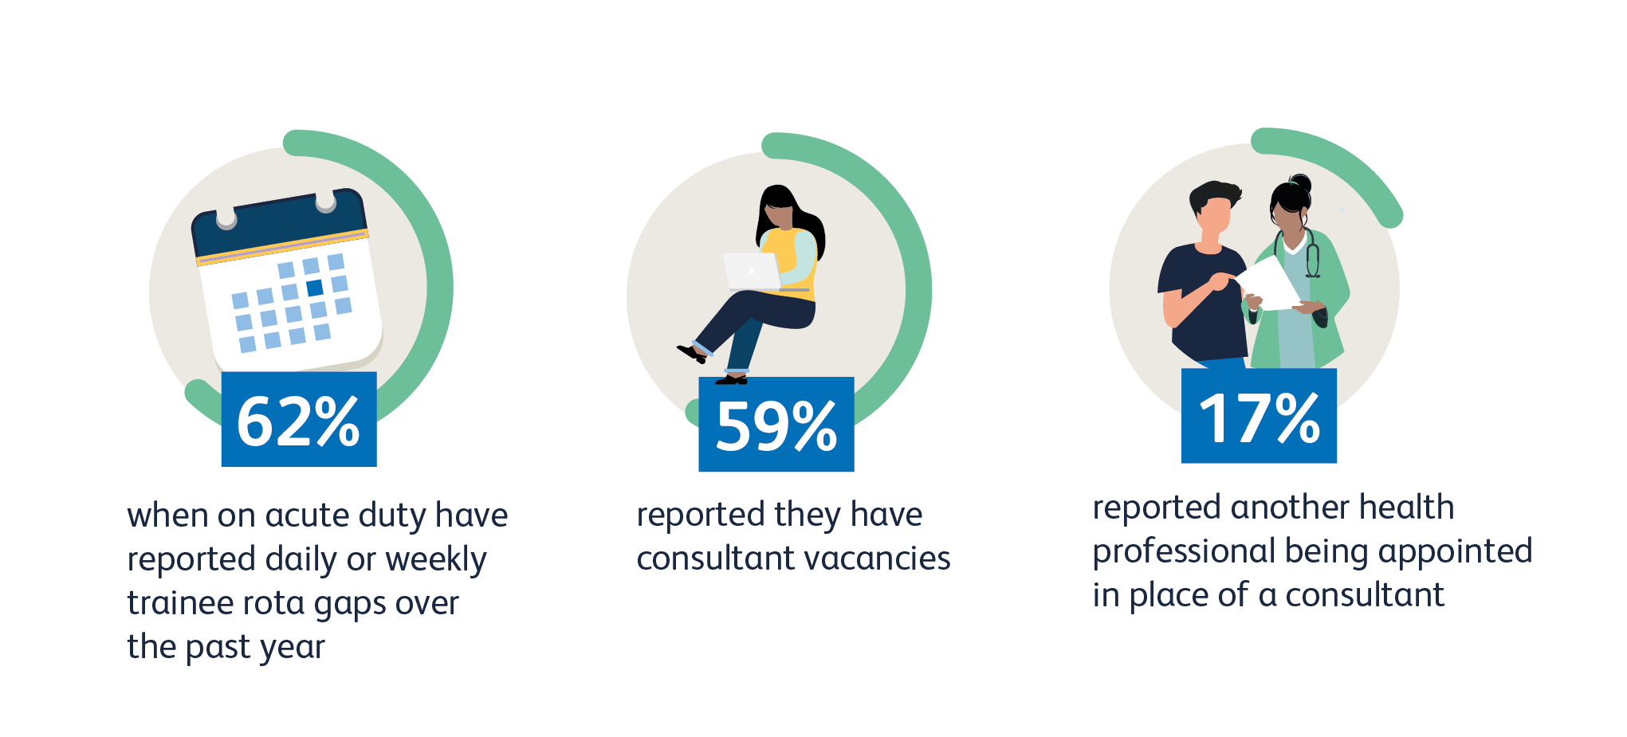
Rota gaps
Based on 3,024 consultant responses

Slide 16
Impact of rota gaps - consultants
Total = 3,024 consultants

Slide 17
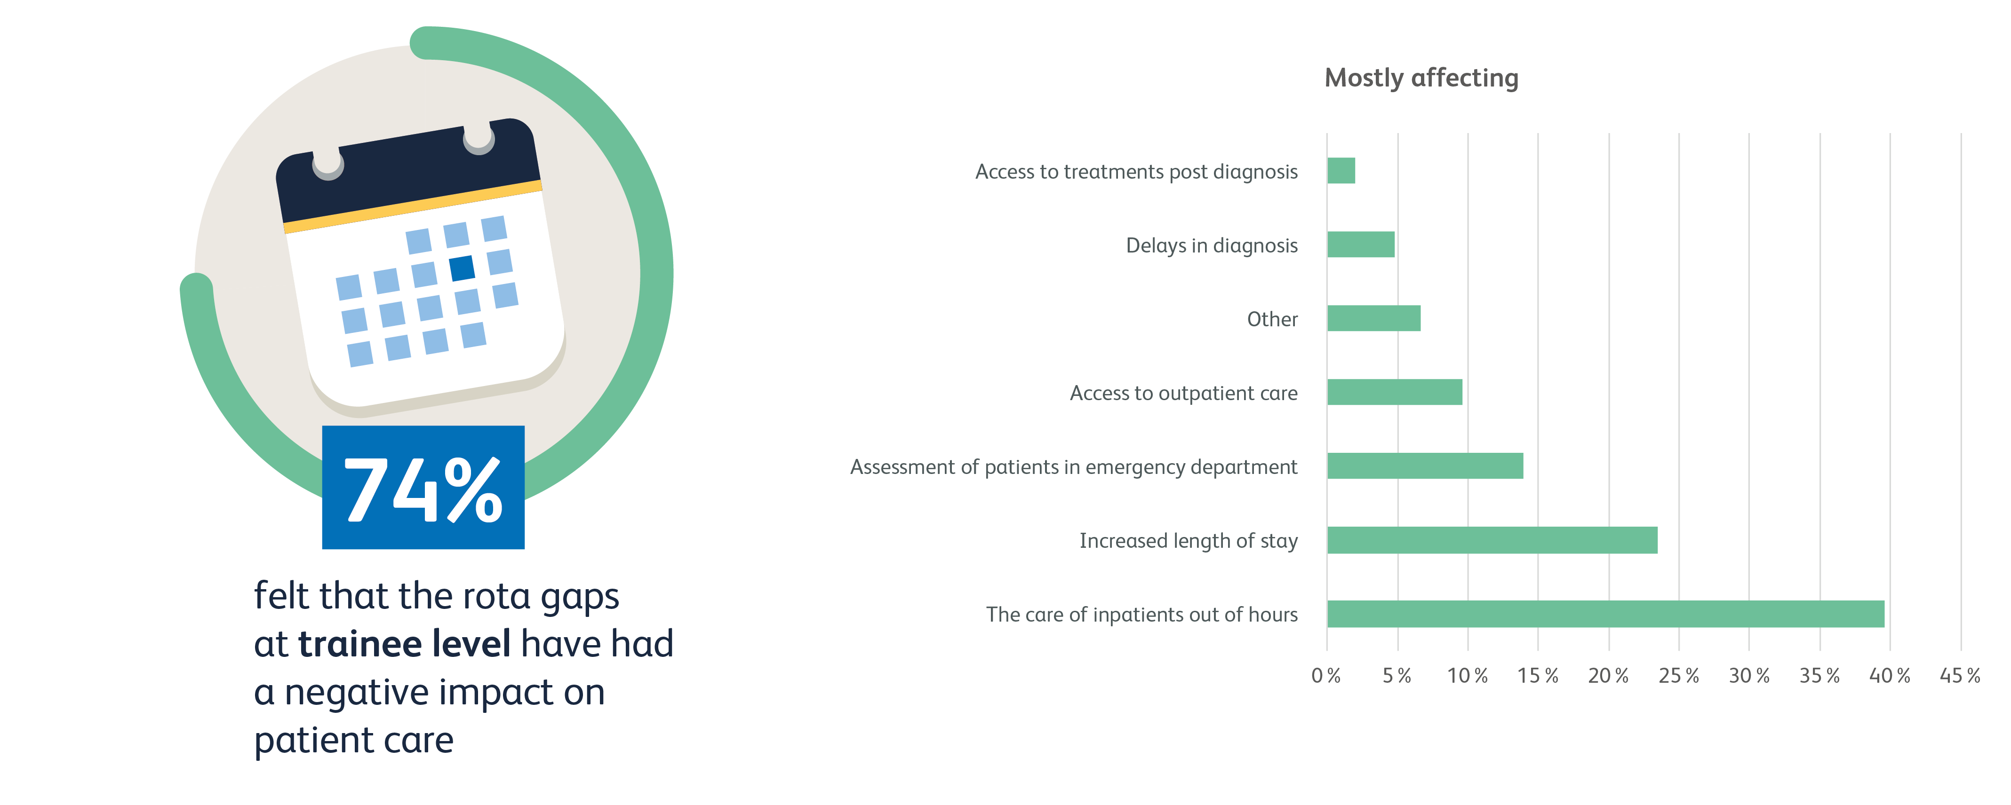
Impact of rota gaps - trainees
Total = 3,024 consultants

Slide 18
Hospital@home and virtual wards
Do you do work on a hospital@home/virtual ward?
Yes | 10% | (334)
No | 90% | (3,167)
How often do you deliver care on a hospital@home/virtual ward?
Daily | 21% | (70)
Weekly | 43% | (143)
Monthly | 27% | (89)
Once or twice a year | 9% | (30)
How many patients are under your care on a hospital@home/virtual ward on average?
<5 | 31% | (104)
5–10 | 25% | (84)
10–15 | 14% | (47)
15–20 | 10% | (32)
>20 | 20% | (67)
Based on 3,501 consultant responses

Slide 19
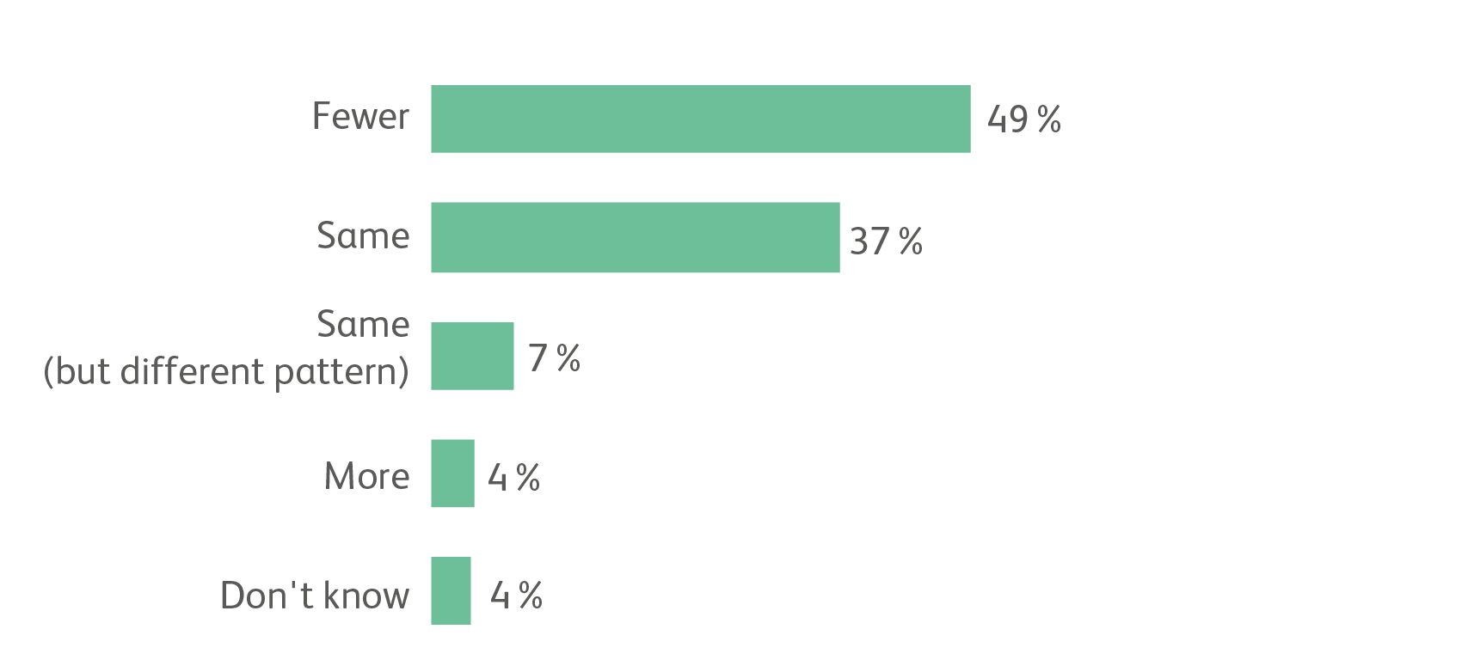
Do consultants want to work fewer, more or the same number of PAs in future?
Based on 3,139 consultant responses

Slide 20
Job plans
What are the top three activities that get squeezed out of your week when things get too busy?
Continuing professional development
Quality improvement activity
Education, training and supervision of doctors (of all grades, including appraisal of colleagues)
Based on 3,097 consultant responses

Slide 21
Job plans (continued)
Based on 3,097 consultant responses, multiple answers allowed.

Slide 22
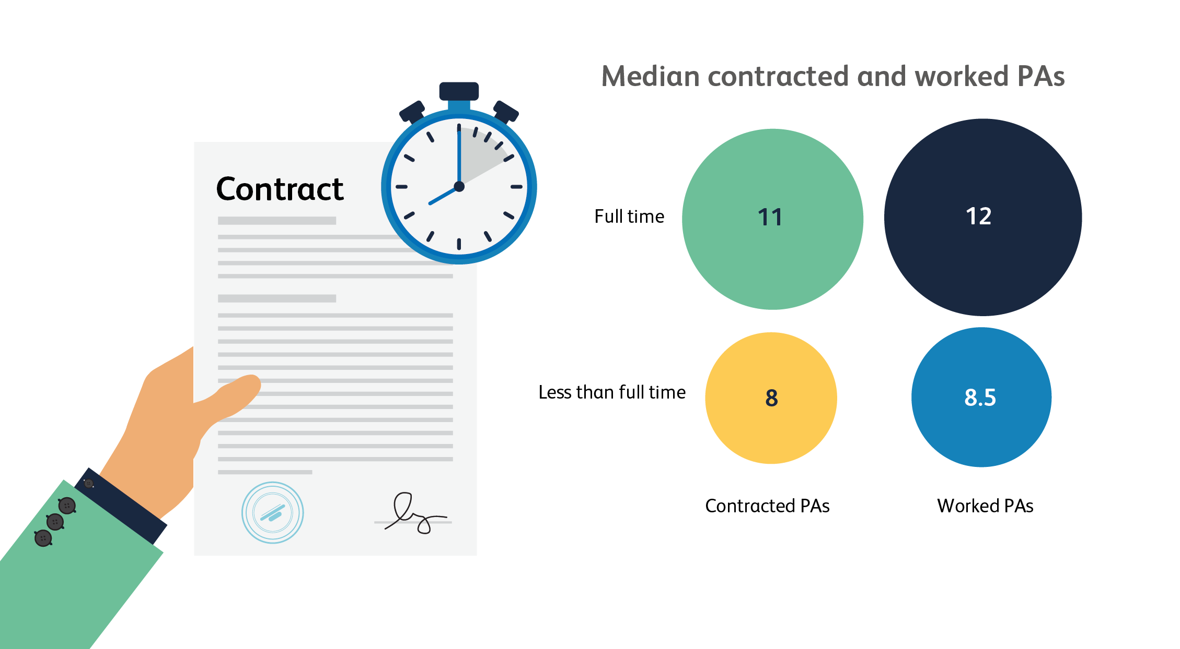
Median contracted and programmed activities (PAs) of consultants
Based on 3,108 consultant responses

Slide 23
Did you take your full annual leave allocation for the past year?
Total based on 3,143 consultant responses

Slide 24
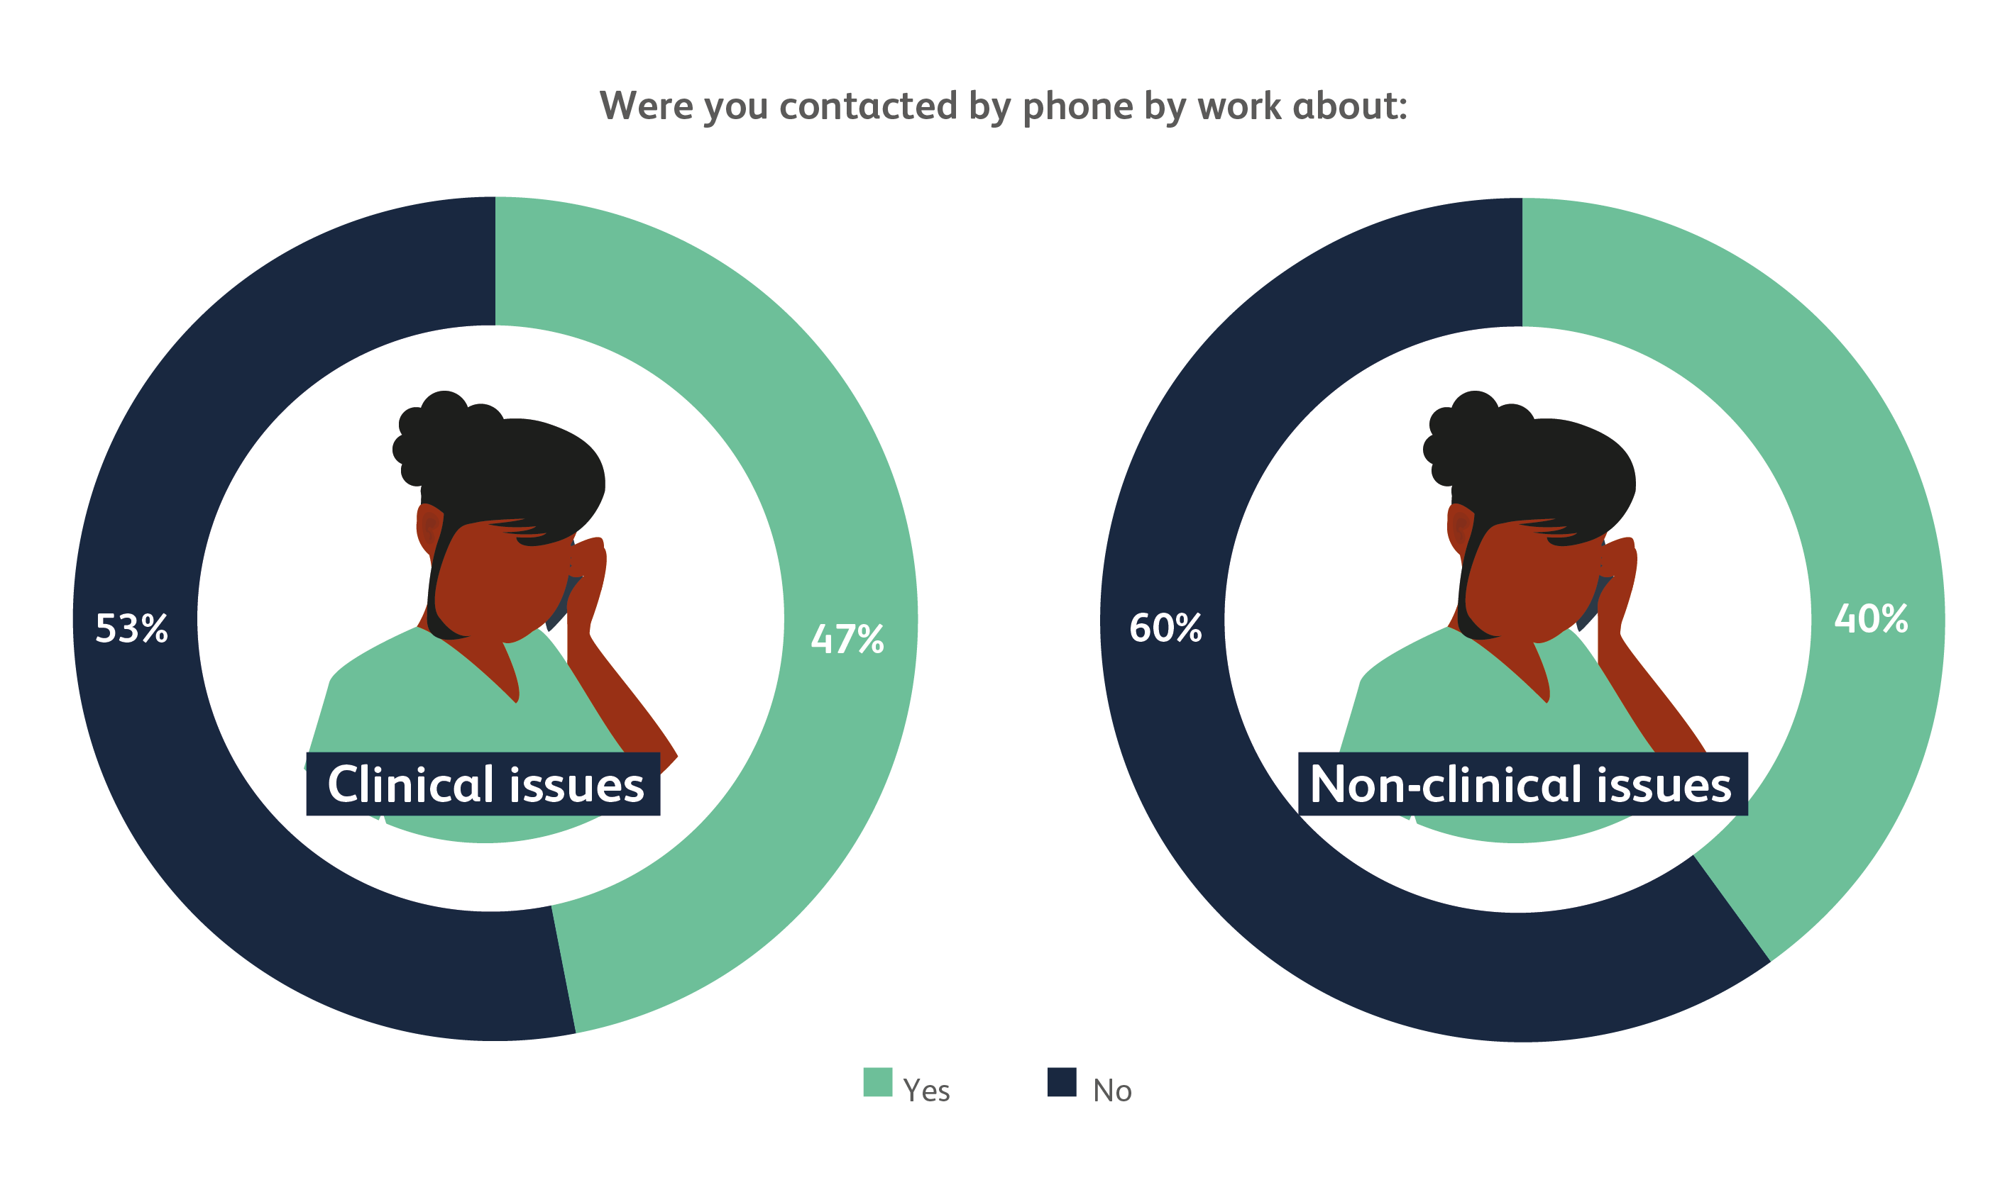
While on annual leave…
Total =3,143 consultant responses

Slide 25
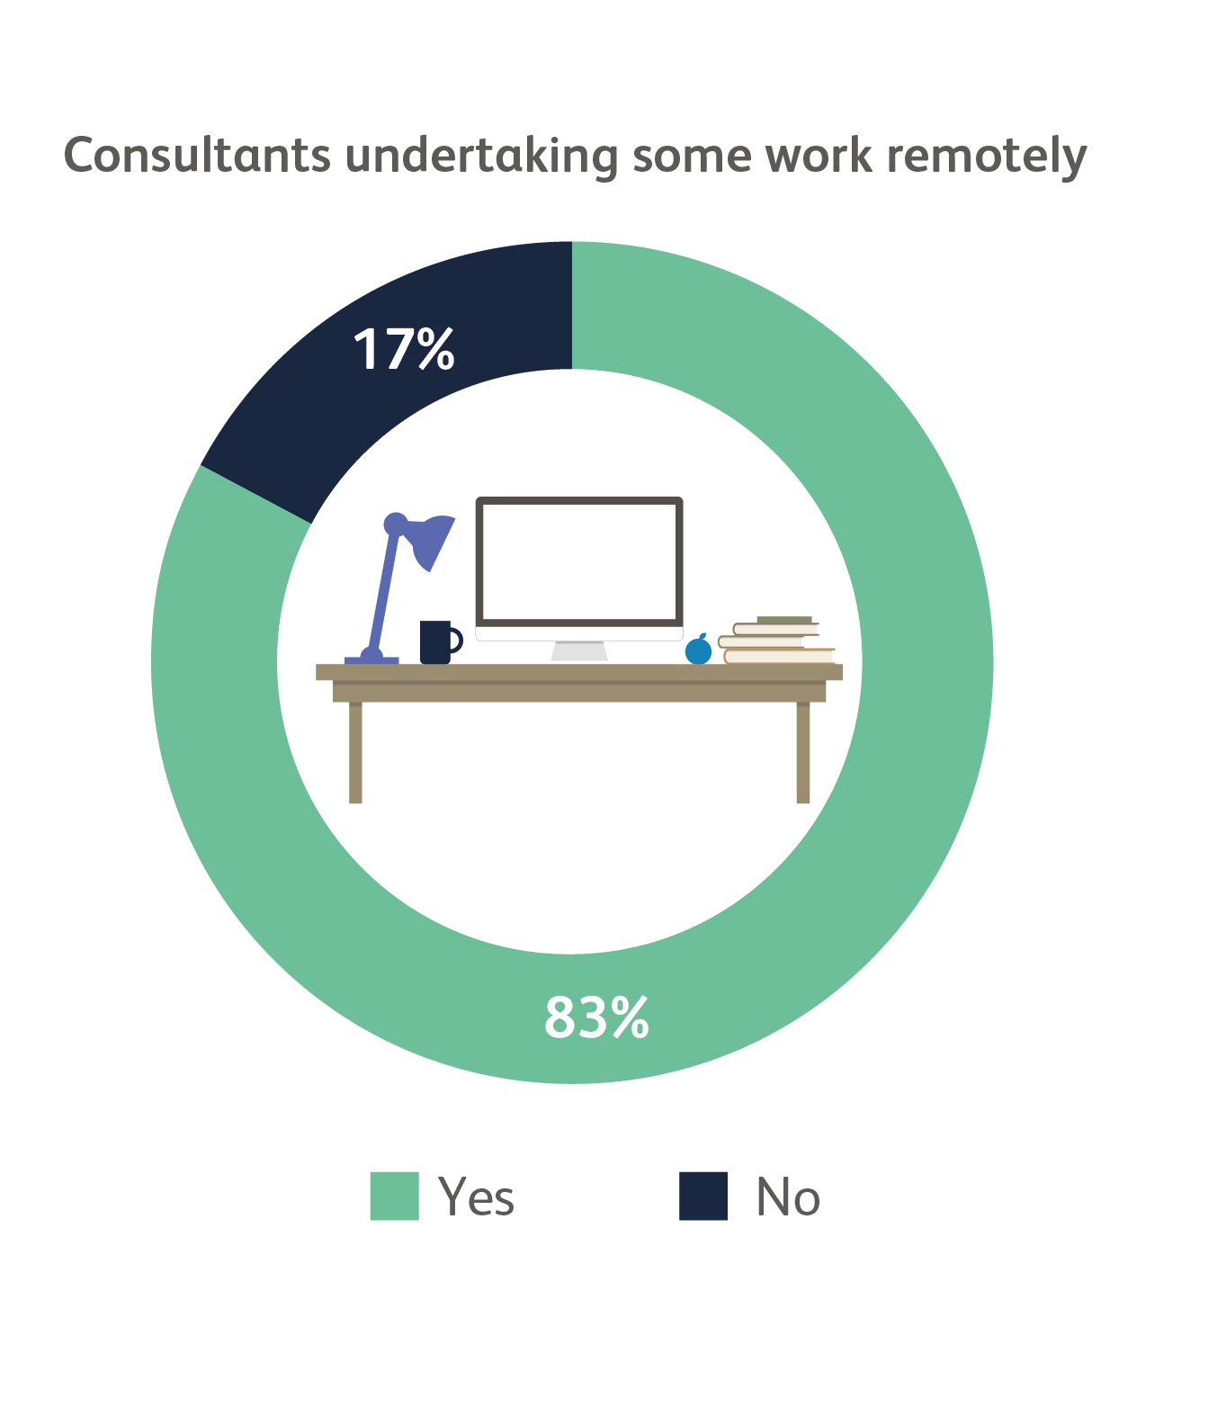
Do you work remotely?
Based on 3,149 consultant responses

Slide 26
Continuing professional development
Did you take any time away from your organisation for continuing professional development (study leave) this year?
Yes | 83% | (2,623)
No | 17% | (563)
How many days did you take off?
Average | 4.9 days
Mode | 5 days
Was this CPD paid for in full by your organisation?
Yes | 55% | (1,423)
No | 45% | (1,180)
If ‘No’ did you self-fund this CPD?
Yes | 82% | (958)
No | 18% | (216)
Based on 3,146 consultant responses

Slide 27
Sick leave
Did you take any days off work due to unexpected illness this year?
Yes | 37% | (1,165)
No | 63% | (1,986)
Was this...
1–3 days | 54% | (623)
4–5 days | 19% | (215)
1–2 weeks | 11% | (130)
>2 weeks | 17% | (192)
Was this due to COVID-19?
Yes | 34% | (396)
No | 66% | (753)
Based on 3,146 consultant responses

Slide 28
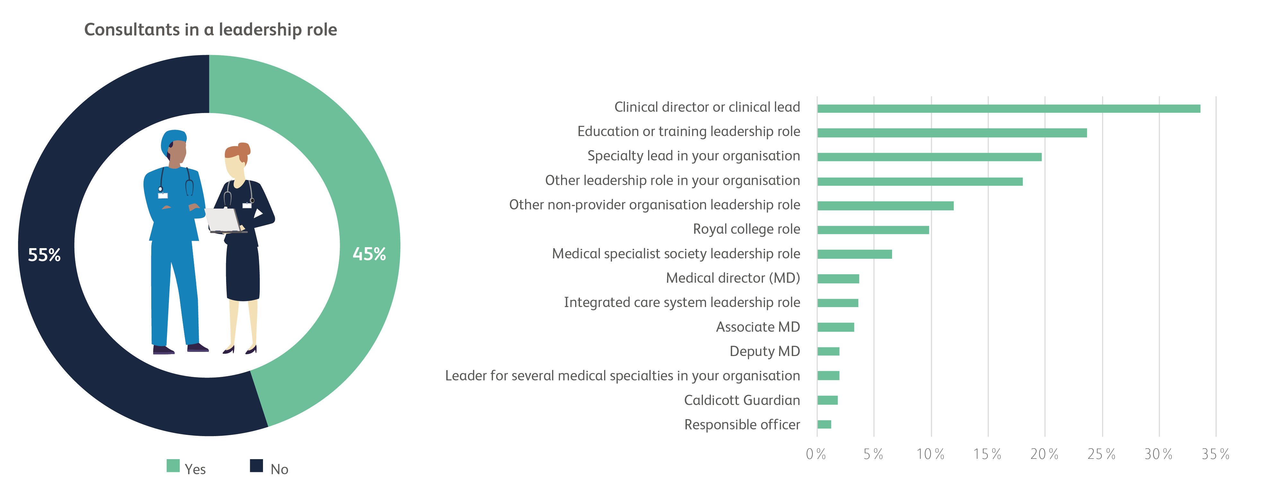
Are you working in a leadership role?
Based on 3,507 consultant responses

Slide 29
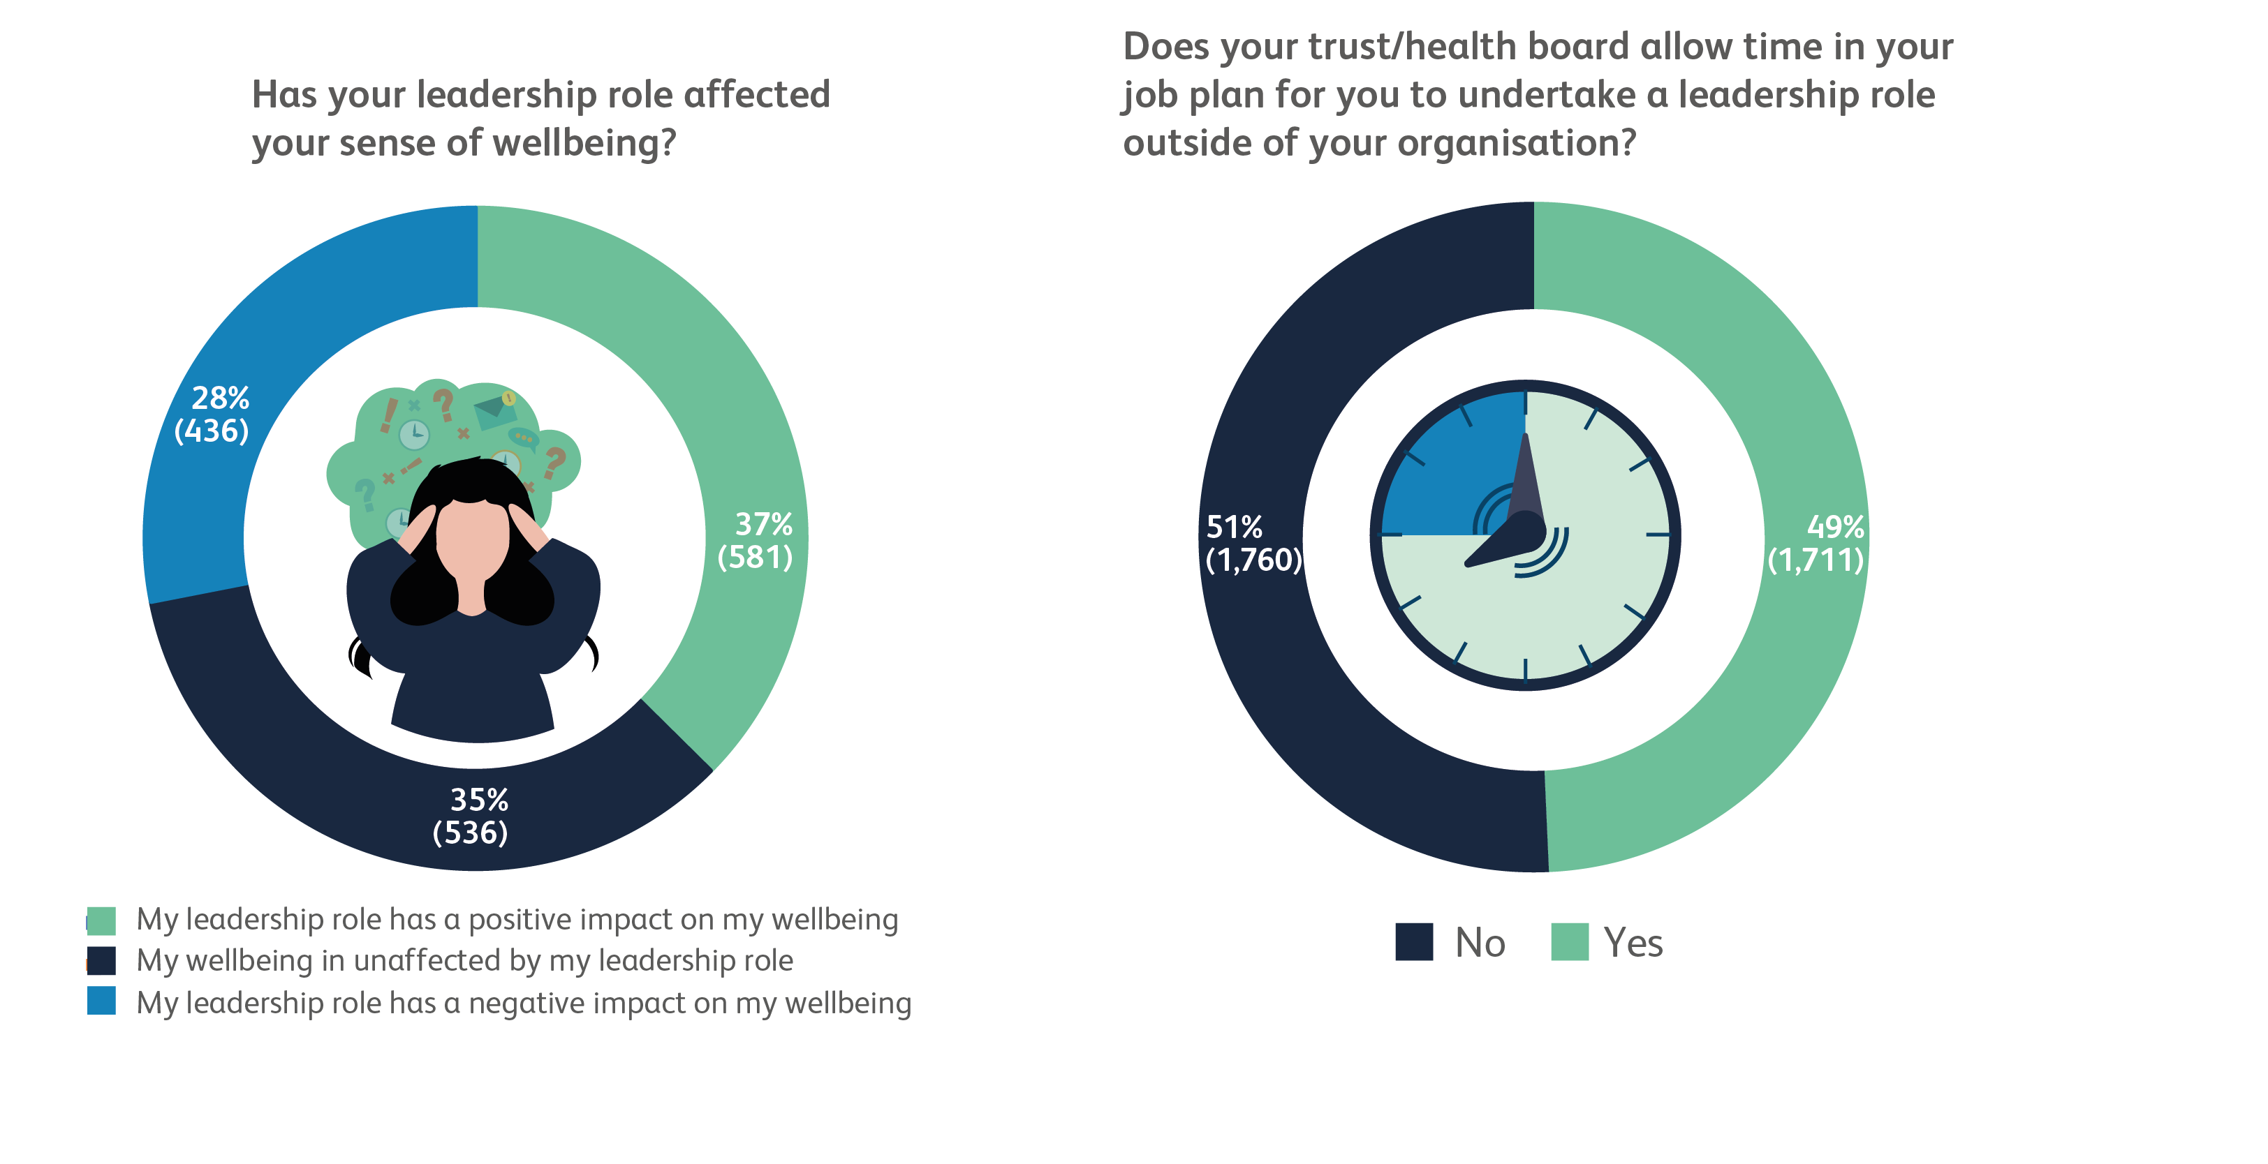
Leadership roles
Based on 1,571 consultant responses

Slide 30
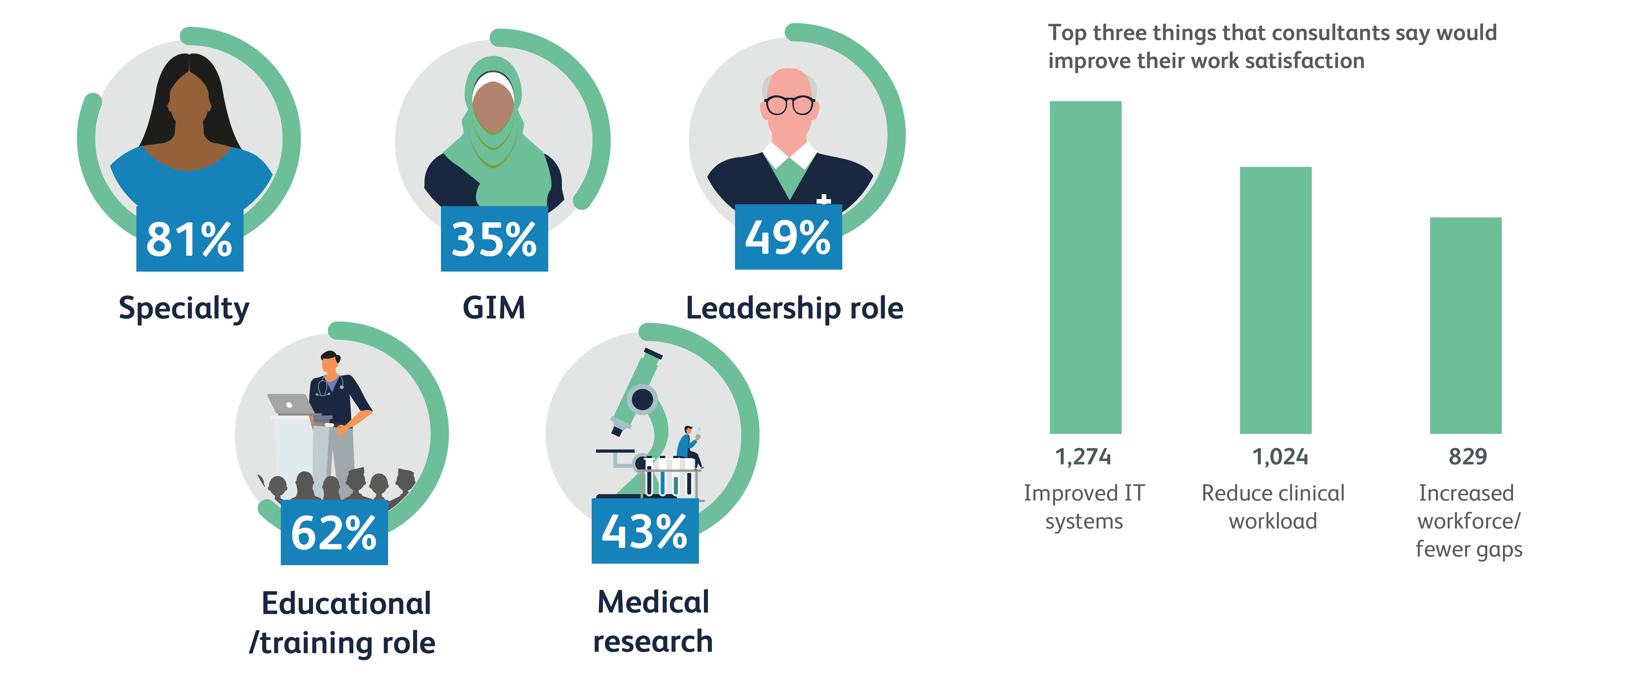
Consultants and job satisfaction % who said they ‘always’ or ‘often’ felt satisfied with different areas of their work
Based on 2,870 consultant responses

Slide 31
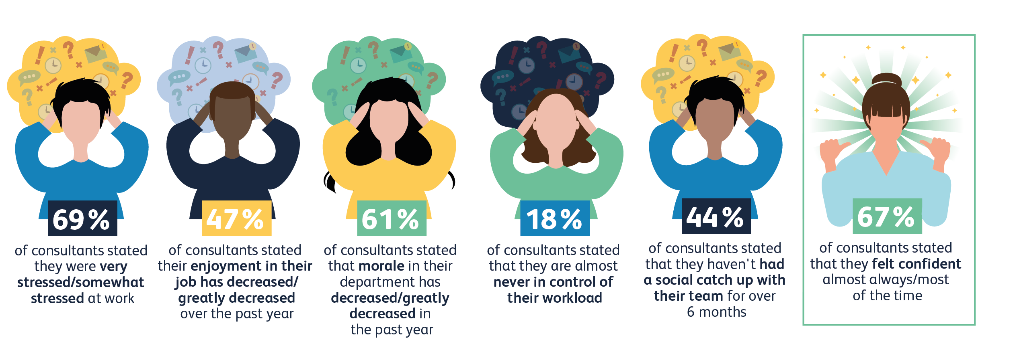
Consultant morale
Based on 2,939 consultant responses

Slide 32
Consultant morale (continued)
Top three factors negatively affecting wellbeing at work.
Clinical workload
Poorly functioning IT equipment
Staff vacancies in your team
Top three positive changes that would make the biggest difference to your wellbeing at work.
Well functioning IT equipment
More administrative support
More capacity in social care to discharge patients in a timely manner
Only 3 options could be selected.
Total = 3,135 responses

Slide 33
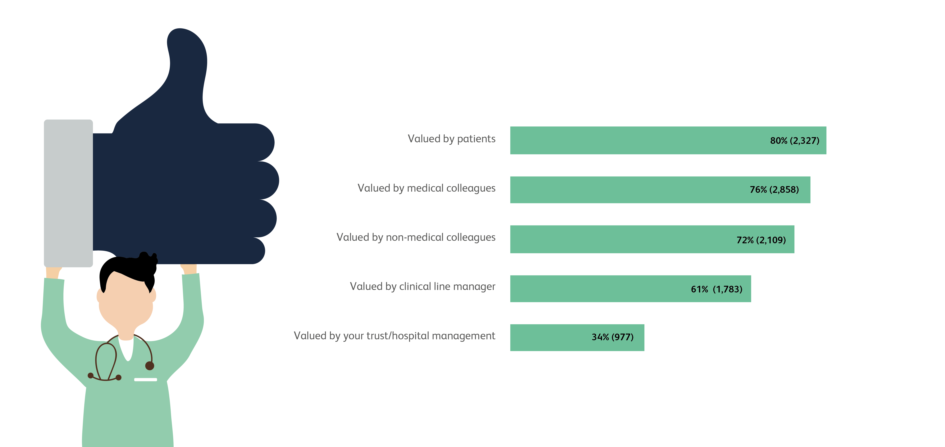
Consultants and feeling valued % who said they felt valued ‘almost always’ or ‘most of the time’
Based on 2,939 consultant responses

Slide 34
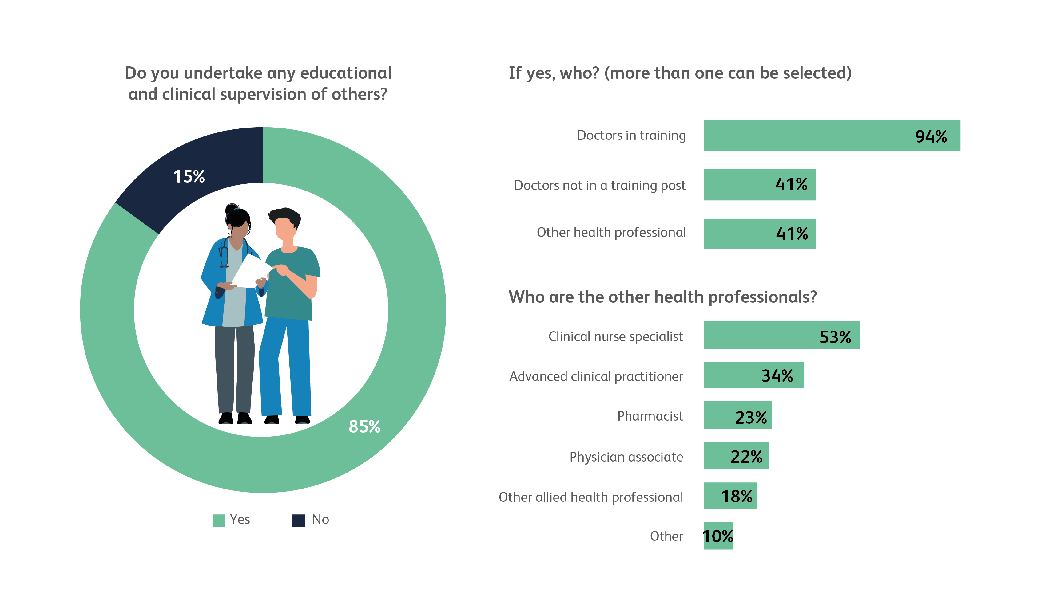
Educational and clinical supervision
Based on 3,138 consultant responses

Slide 35
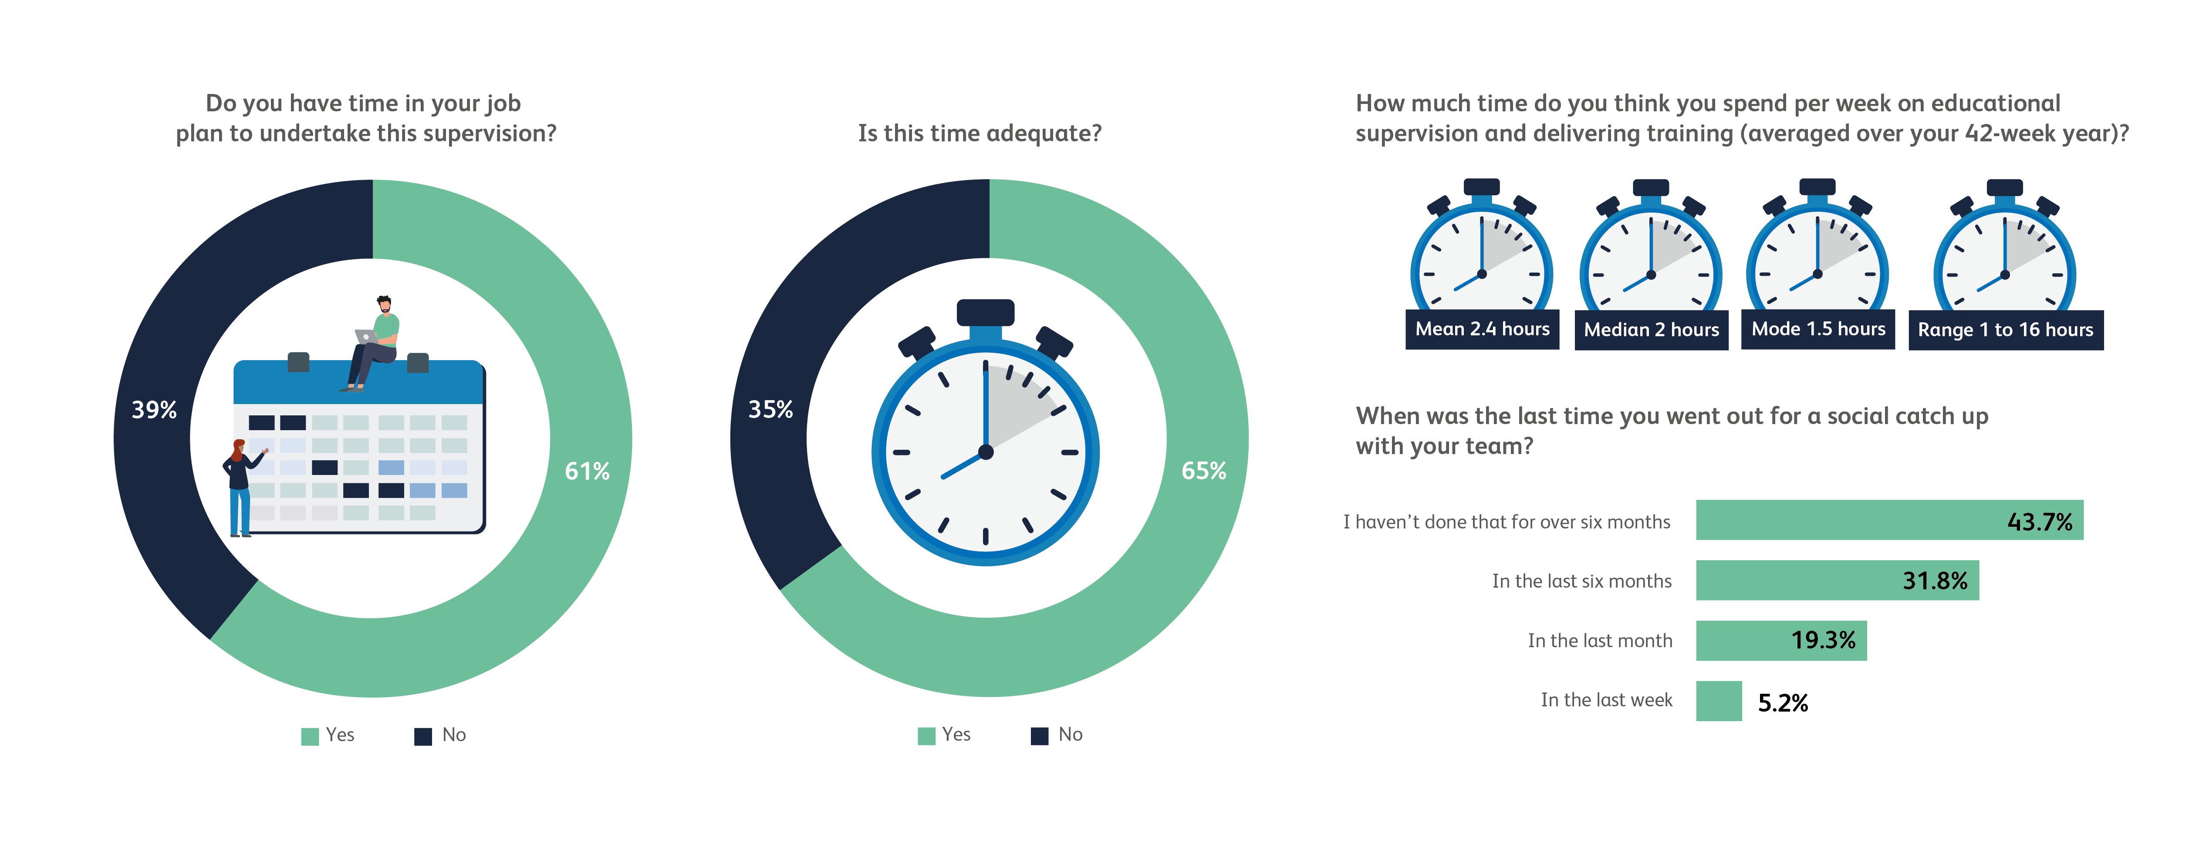
Educational and clinical supervision (continued)
Based on 3,138 consultant responses

Slide 36
Educational and clinical supervision (continued)
Based on 3,138 consultant responses

Slide 37
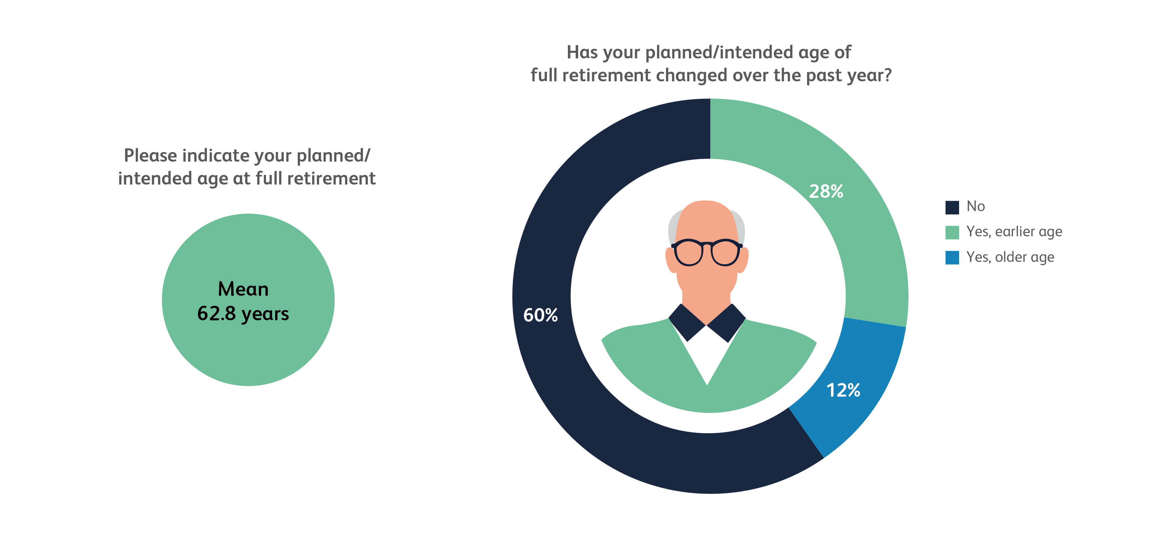
Consultant retirement
Total based on 2,829 consultant responses

Slide 38
Do get in touch medicalworkforce.unit@rcp.ac.uk

