Slide 1
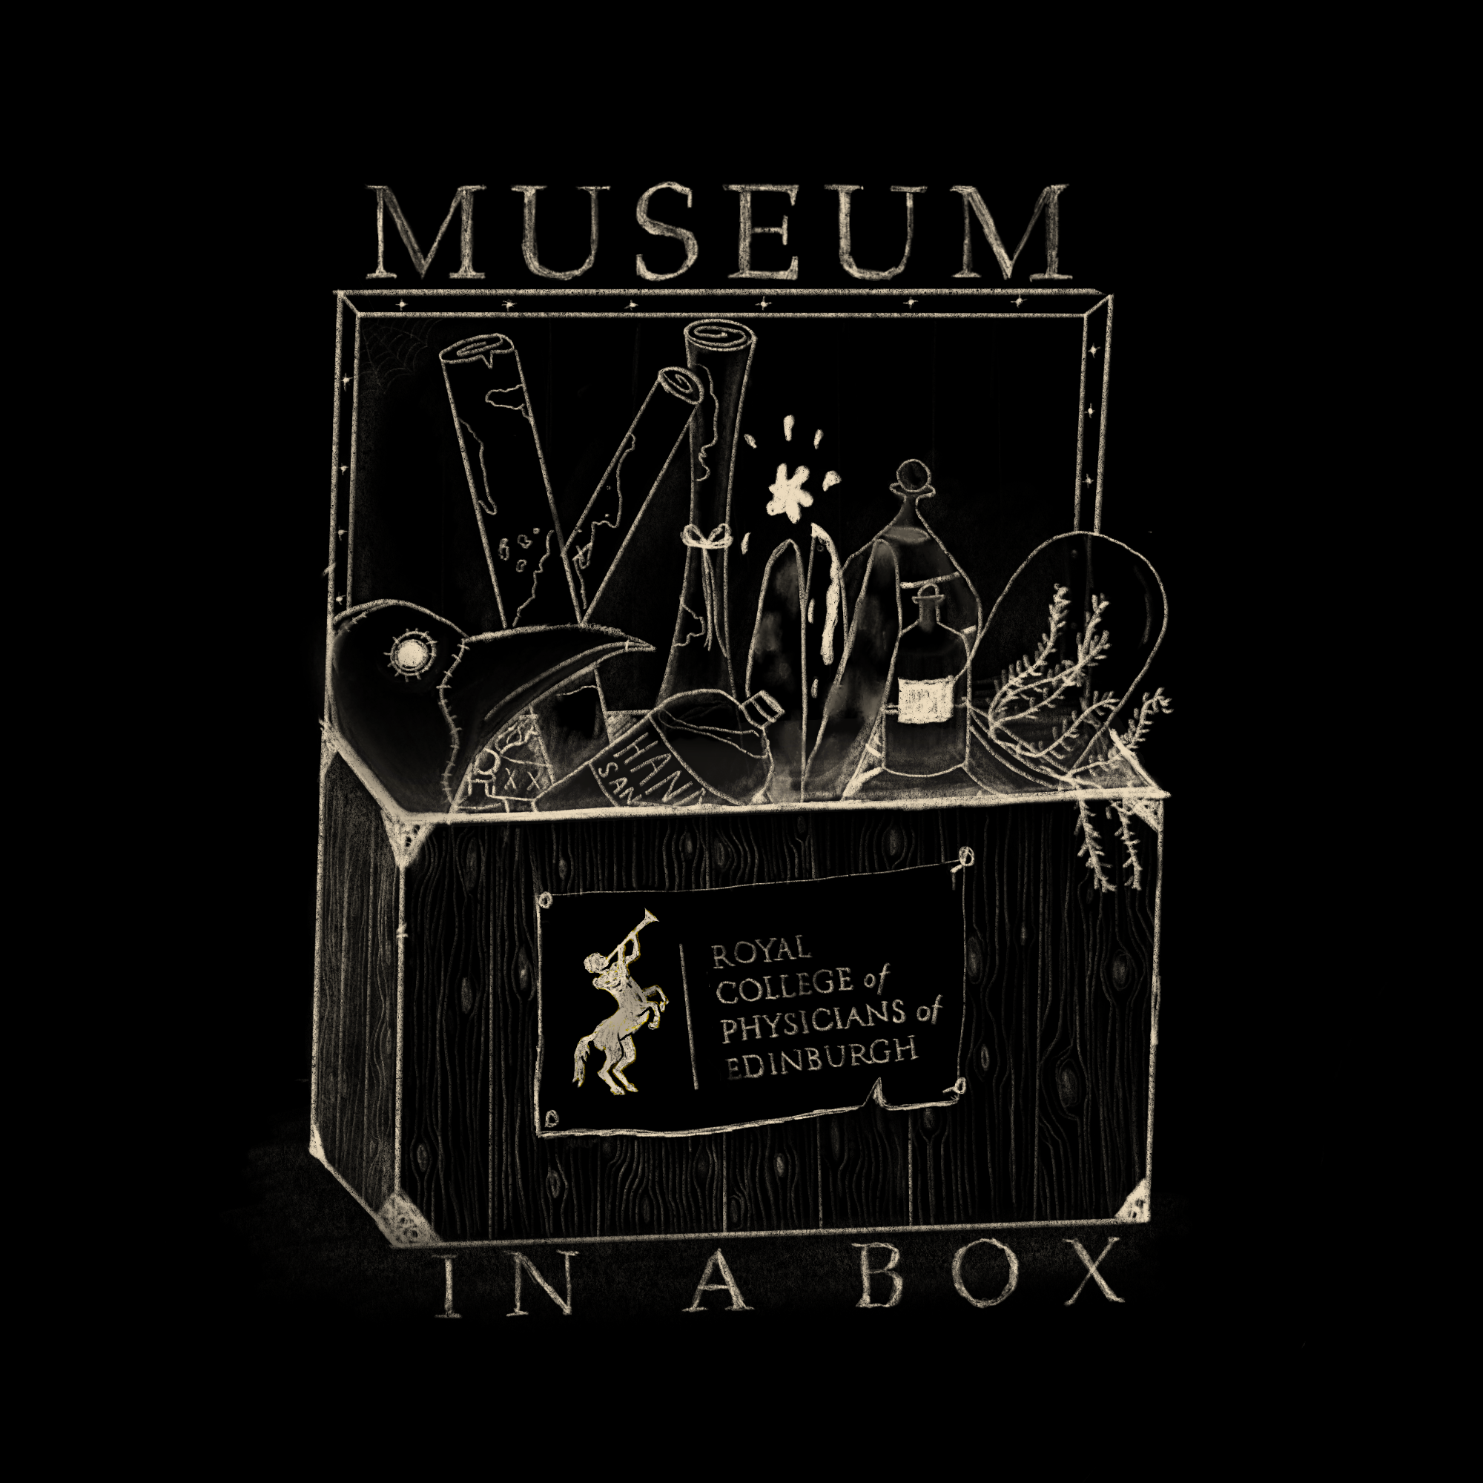
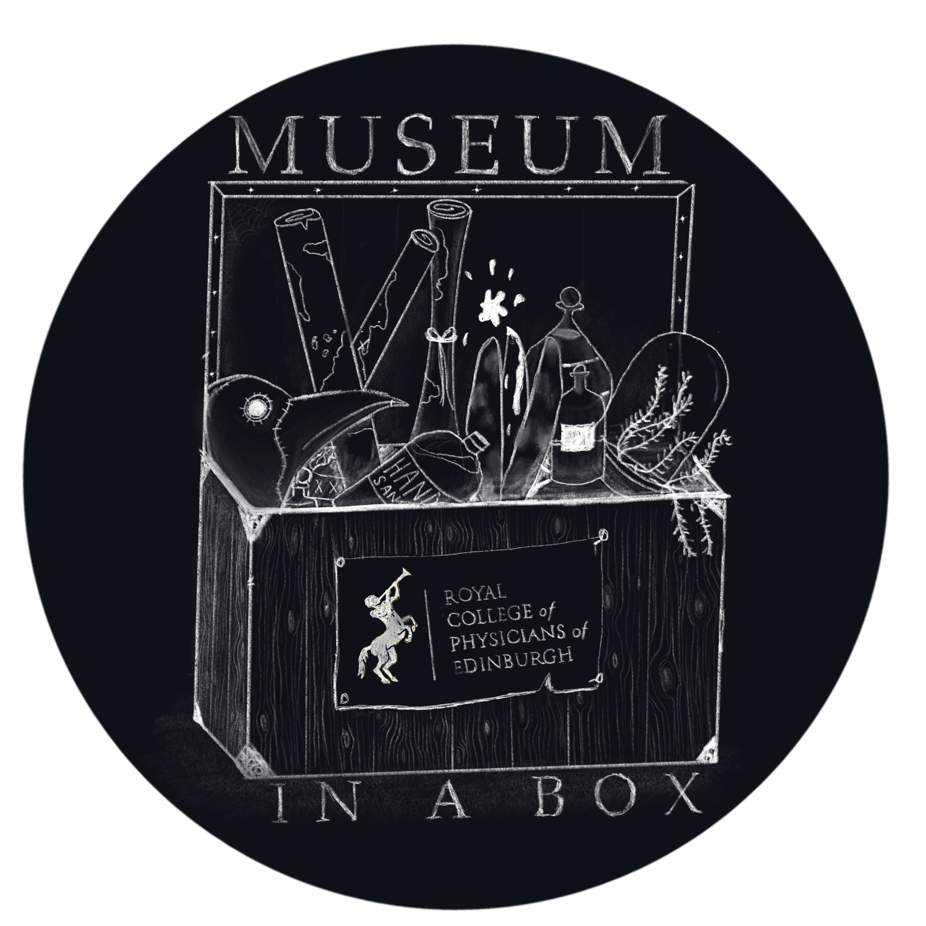
Teacher Guide
“Build a Physik Garden”
OVERVIEW
Students discover the objects in the box to learn what would be needed to create important medicines of that time. They will be tasked with finishing an activity where they are in charge of a physik garden that will be used to source materials to save a village from illness.
Students will use the garden to help their community survive the harsh environment for which their community finds themselves throughout history.
SUPPLIES, EQUIPMENT & RESOURCES
We Supply
Images marked with a PURPLE icon on the label from the felt folder titled RCPE ARCHIVE. See below for a complete list
Objects from the box marked with a PURPLE icon on their individual interpretation panels. See below for a complete list
The folder titled “Build a Physik Garden” found in the felt folder titled RCPE ACTIVITIES
From the felt folder labeled as ARCHIVES
All papers in the RCPE ARCHIVES felt folder are useful for reference. They are not directly associated with the activity, but can be referenced as examples of materials being farmed and sourced during the medicine-making process.
From The Box
All objects in the box are useful for reference. They are not directly associated with the activity, but can be referenced as examples of materials being farmed and sourced during the medicine-making process.
Look for THIS COLOUR
on the labels of the objects
and archives in the box.
They will be used in this activity.

Slide 2
BEFORE CLASS
You will need to divide the class into four groups. If the class does not split evenly into groups of four, add an extra student into groups of five.
Place the archives and objects around the room.
INTRODUCTION AND INSTRUCTION
Have students watch the video (or read out instructions) on how to handle objects and instruct them to prepare themselves and their stations for object handling accordingly.
Ask students to have a look at the various objects and archives. Ask them to:
take note of the diversity of ingredients and source materials
consider how these materials were made available to physicians to make medicine
Divide students into groups of four.
While they are preparing stations pass out the provided worksheet to each student.
You should keep the stack of event cards for yourself.
SHARING AND DOING
Next, explain to students they will be in charge of keeping their town healthy from the disease that may happen on the event cards. They will be able to grow items in their individual physik garden, which will help make the medicine they need. Instruct your students to “plant” their physik garden using the transparent game pieces provided. They are able to plant 36 plants at a time. Game pieces look similar to Tetris pieces, which makes it more difficult to fill the physik garden. The game pieces cannot overlap each other.
A round begins when the teacher draws an event card and reads it out loud. Based on what happens on the event card, students will then remove certain plant game pieces off of their board. Four cards are drawn by the teacher every round. After the round, the students count how many events they survived, and how many they did not. After each round, the students are able to replant items in their garden once more.
The rounds continue for as long as possible. The winners are determined by how many times the village survived the events.

Slide 3
RESULTS, REVIEWING & REFLECTING
Students should tidy their station for the next class (if applicable) and return all of the documents back into the sealed envelopes.
If there is time, you may want to ask the reflective questions below.
When you looked at the objects from the box, did you notice where the objects came from? Look again, are you surprised at how far things need to travel in order to make medicine?
Apothecaries and dispensaries were in charge of keeping a supply of medical ingredients, sometimes physicians would grow the ingredients themselves. What are some challenges apothecaries and physicians would face as they would accumulate medical ingredients?
Did you have difficulty supplying your “village” with what it needed to survive illness?
POTENTIAL ASSESSMENT STRATEGIES
PRE ASSESS: Sometimes an illness can “plague” a community, a country, a world. How does that illness affect the demand of some supplies and medicines?
POST ASSESS: Are there easy ways to predict what sort of medicines people will need to help them feel better? If so, what is that “easy way” If not, what are the reasons it is so hard to predict?
A NOTE REGARDING STUDENTS WITH PROTECTED CHARACTERISTICS
Group work is required to “save the village” Independent work is difficult in this activity. As an alternative, a solo student can plot the source of all materials in the box on a separate sheet of paper if group work is not possible.
Some of the objects in the box are very fragrant. Overstimulation may occur. Please remove these objects if you foresee an issue. It will not affect the result of this activity.

Slide 4
OBJECTIVES and STANDARDS
Physik gardens were used by physicians and apothecaries to source the materials they would need to make medicine.
SOC 306-b Through research, I can identify possible causes of a past conflict and report
on the impact it has on the lives of people at that time.
LIT 3-04a As I listen or watch, I can:
Identify and give an accurate account of purpose and main concerns of the text, and can make inferences from key statements
Identify and discuss similarities and differences between different types of text
Use this information for different purposes.
There were several physik gardens in Edinburgh, beginning in the 14th century. There are still physik gardens in Edinburgh today.
SOC 3-06a I can discuss the motives of those involved in a significant turning point
in the past and assess the consequences it had then and since.
LIT 3-06a I can independently select ideas and relevant information for different purposes, organise essential information or ideas and any supporting detain in logical order, and use suitable vocabulary to communicate effectively with my audience.
Physicians and apothecaries needed to have a firm grasp on the basics of botanical gardens so they could till, water, and harvest appropriately.
SOC3-05 I can describe the factors contributing to a major social, political or economic change in the past and can assess the impact on people’s lives.
Material from physik gardens can still be found in regular back gardens, and even in our markets. Items such as rhubarb, oatmeal, and nettles were grown for medicinal purposes, and for everyday consumption.
SOC 3-01a I can use my knowledge of a historical period to interpret the evidence and present an informed view
SOC 3-14a I can use a range of maps and geographical information systems to gather, interpret, and present conclusions and can locate a range of features within Scotland, UK, Europe, and the wider world.
THANK YOUS and CONTACT INFORMATION
Thank you for trying our box and our activities! We appreciate how hard teachers work and hope that these objects and activities have been a delight for you and your students.
If you have any comments or questions please reach out at:
museum@rcpe.ac.uk
0131 225 7324
We would love to hear about your experiences. If you have a moment, consider giving us some quick feedback. It will help us make better tools for you and your students.

