Slide 1
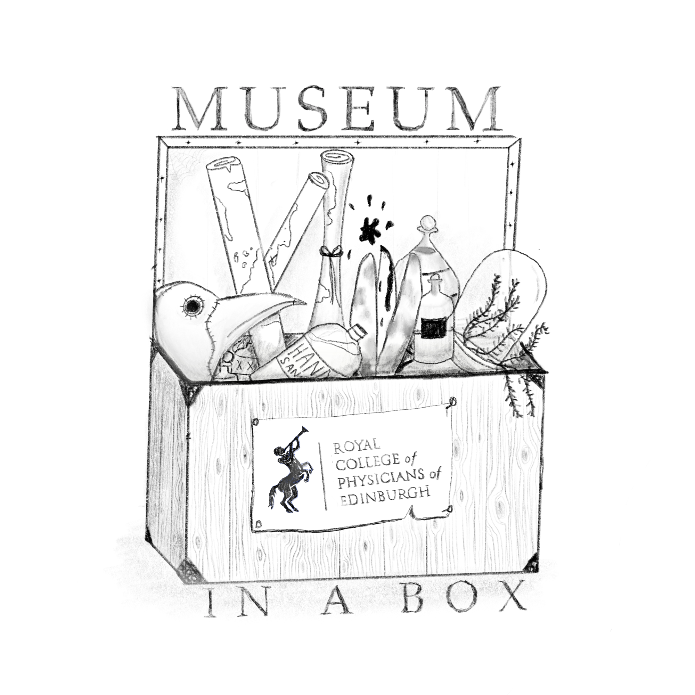
Lady Mary Wortley Montagu Portrait
Lady Mary Wortley Montagu introduced the process of variolation against smallpox to Britain after learning of the practice while in Turkey. Variolation began as a practice of deliberately infecting patients with mild smallpox to develop the patient’s immunity to further attacks. Smallpox was widely considered a childhood disease, prompting Lady Montagu to variolate her own children.

Slide 2
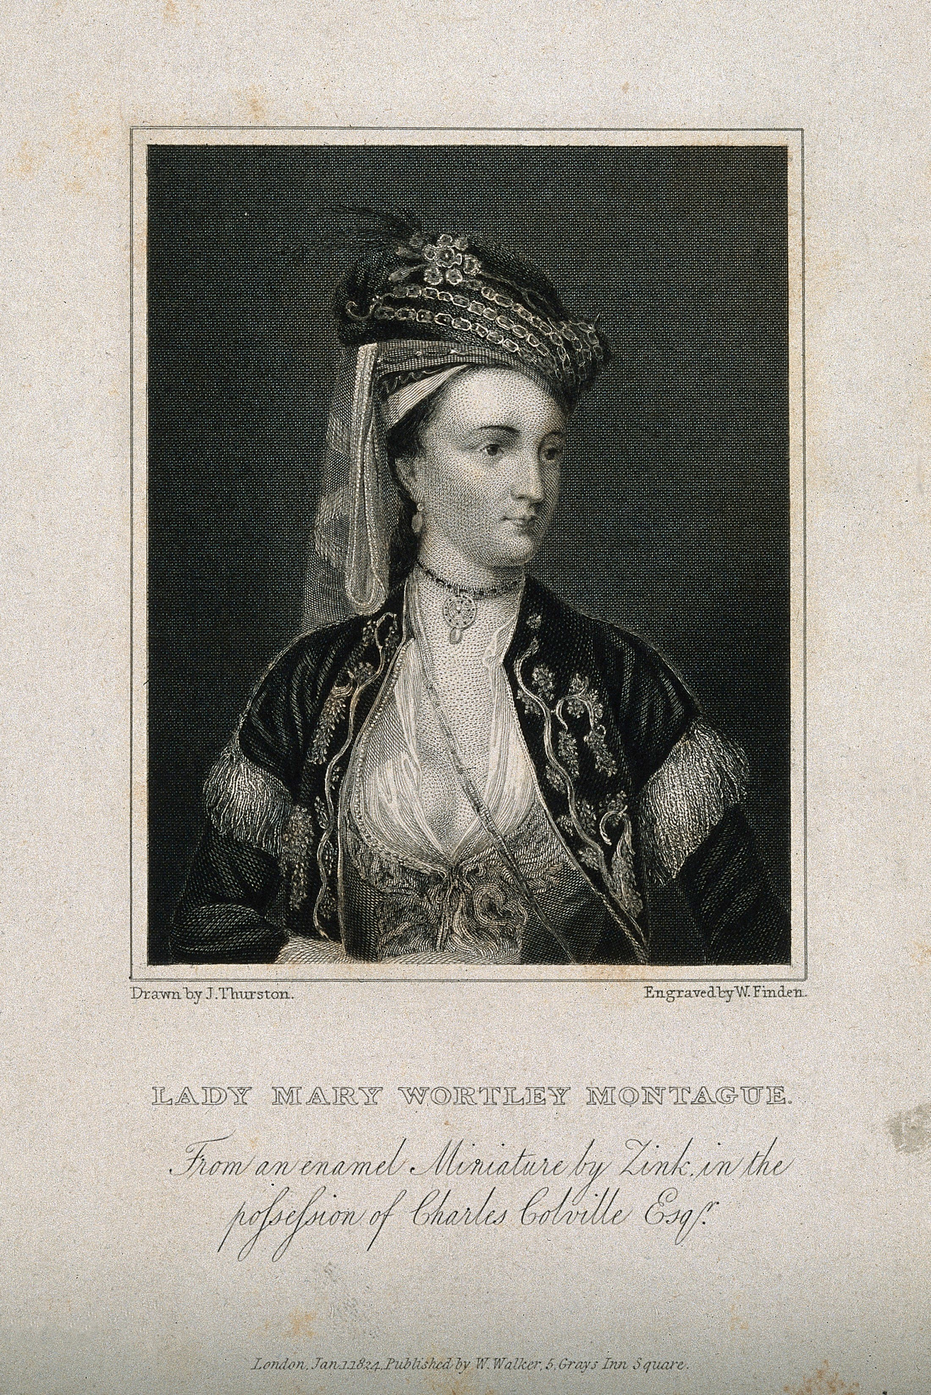
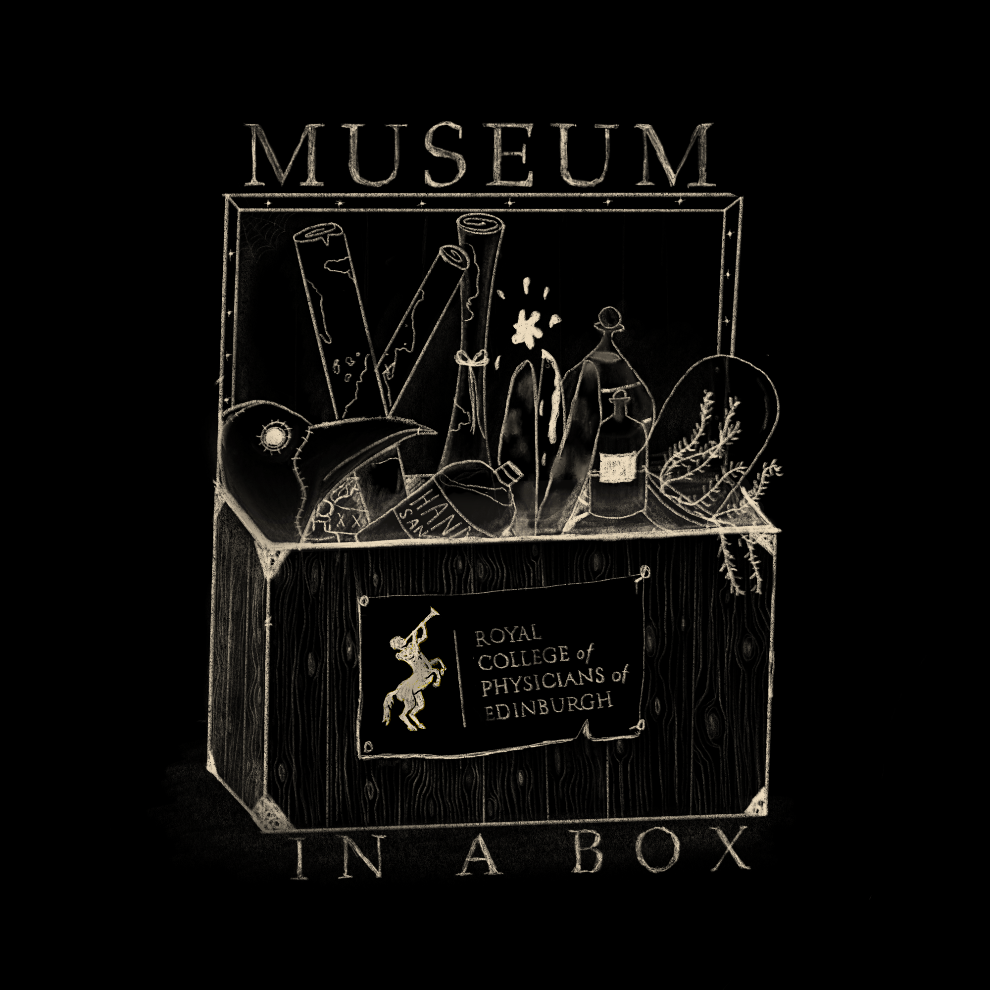
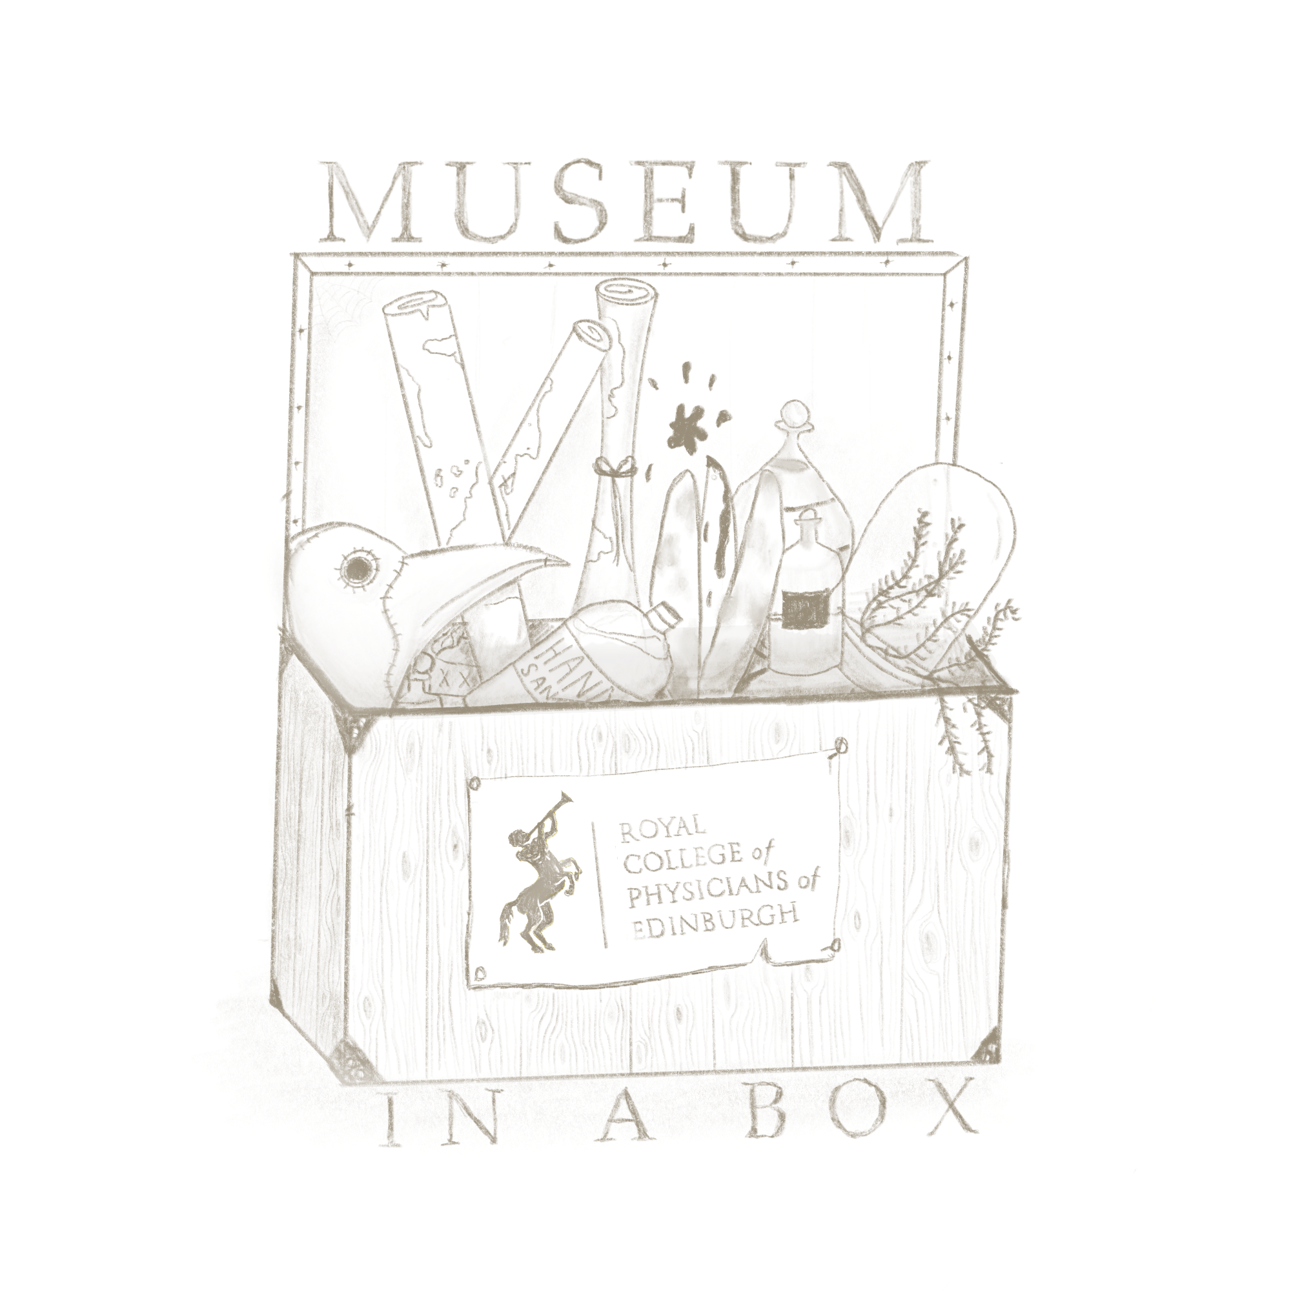
Lady Mary Wortley Montagu Portrait
Date of original: 1824
Material: Ink and paper
Object origin: United Kingdom
Reproduction: Yes
Preparation: Printed material
STATION “D”

Slide 3
Lancet
Lancets were used to variolate patients against smallpox. Patients received a small cut from a blade infected with matter from a smallpox patient, either taken directly from a boil or preserved as a scab from a wound. It was first introduced in the early 1700s but was a controversial and expensive practice. By the end of the 1700s the practice became more universally accepted as the technique improved and cost decreased.

Slide 4
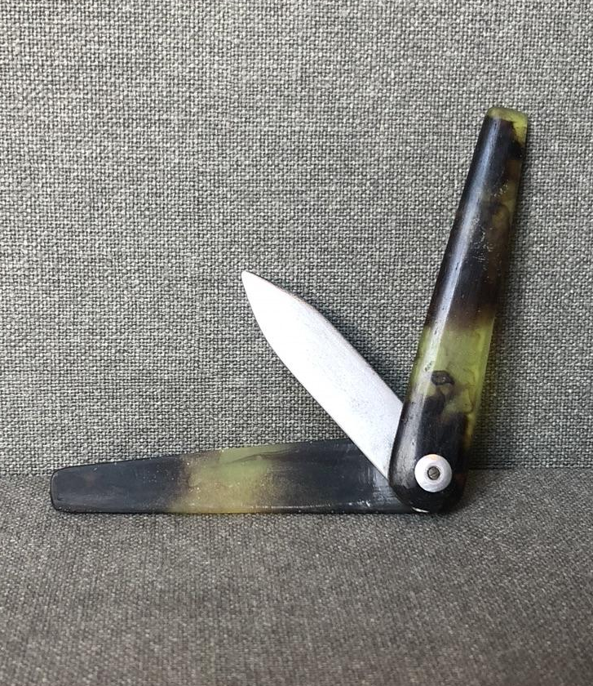
Lancet
Date of original object: c.Mid 1700s
Material: Bone casing and metal blade
Object origin: United Kingdom
Reproduction: Yes
Preparation: Original object cast
and reproduced in plastic.
STATION “D”

Slide 5
Ivory Points
Ivory points were designed by the physician Edward Jenner as tools to vaccinate against smallpox. Only 2.5 cm in length, the points could rub or scratched infective matter into a patient's arm. Edward Jenner was an English physician widely credited with developing the vaccine for smallpox.

Slide 6
Ivory Points
Date: 2020
Material: Ink and paper
Object origin: United Kingdom
Reproduction: Yes
Preparation: Printed material
STATION “D”

Slide 7
Cowpox Medical Illustration - Edward Jenner
Cowpox and smallpox are different diseases that develop from similar viruses. Both result in fevers and large pustules developing on the body. A person who has survived cowpox also develops immunity to smallpox. Due to their more frequent contact with cowpox milkmaids were considered immune to smallpox. Edward Jenner used this theory in 1796 when he first began experimenting with smallpox vaccines by vaccinating a young boy with cowpox. The boy developed a mild fever but survived. He then exposed the child to smallpox. Having already been exposed to cowpox, the child did not react to the smallpox.

Slide 8
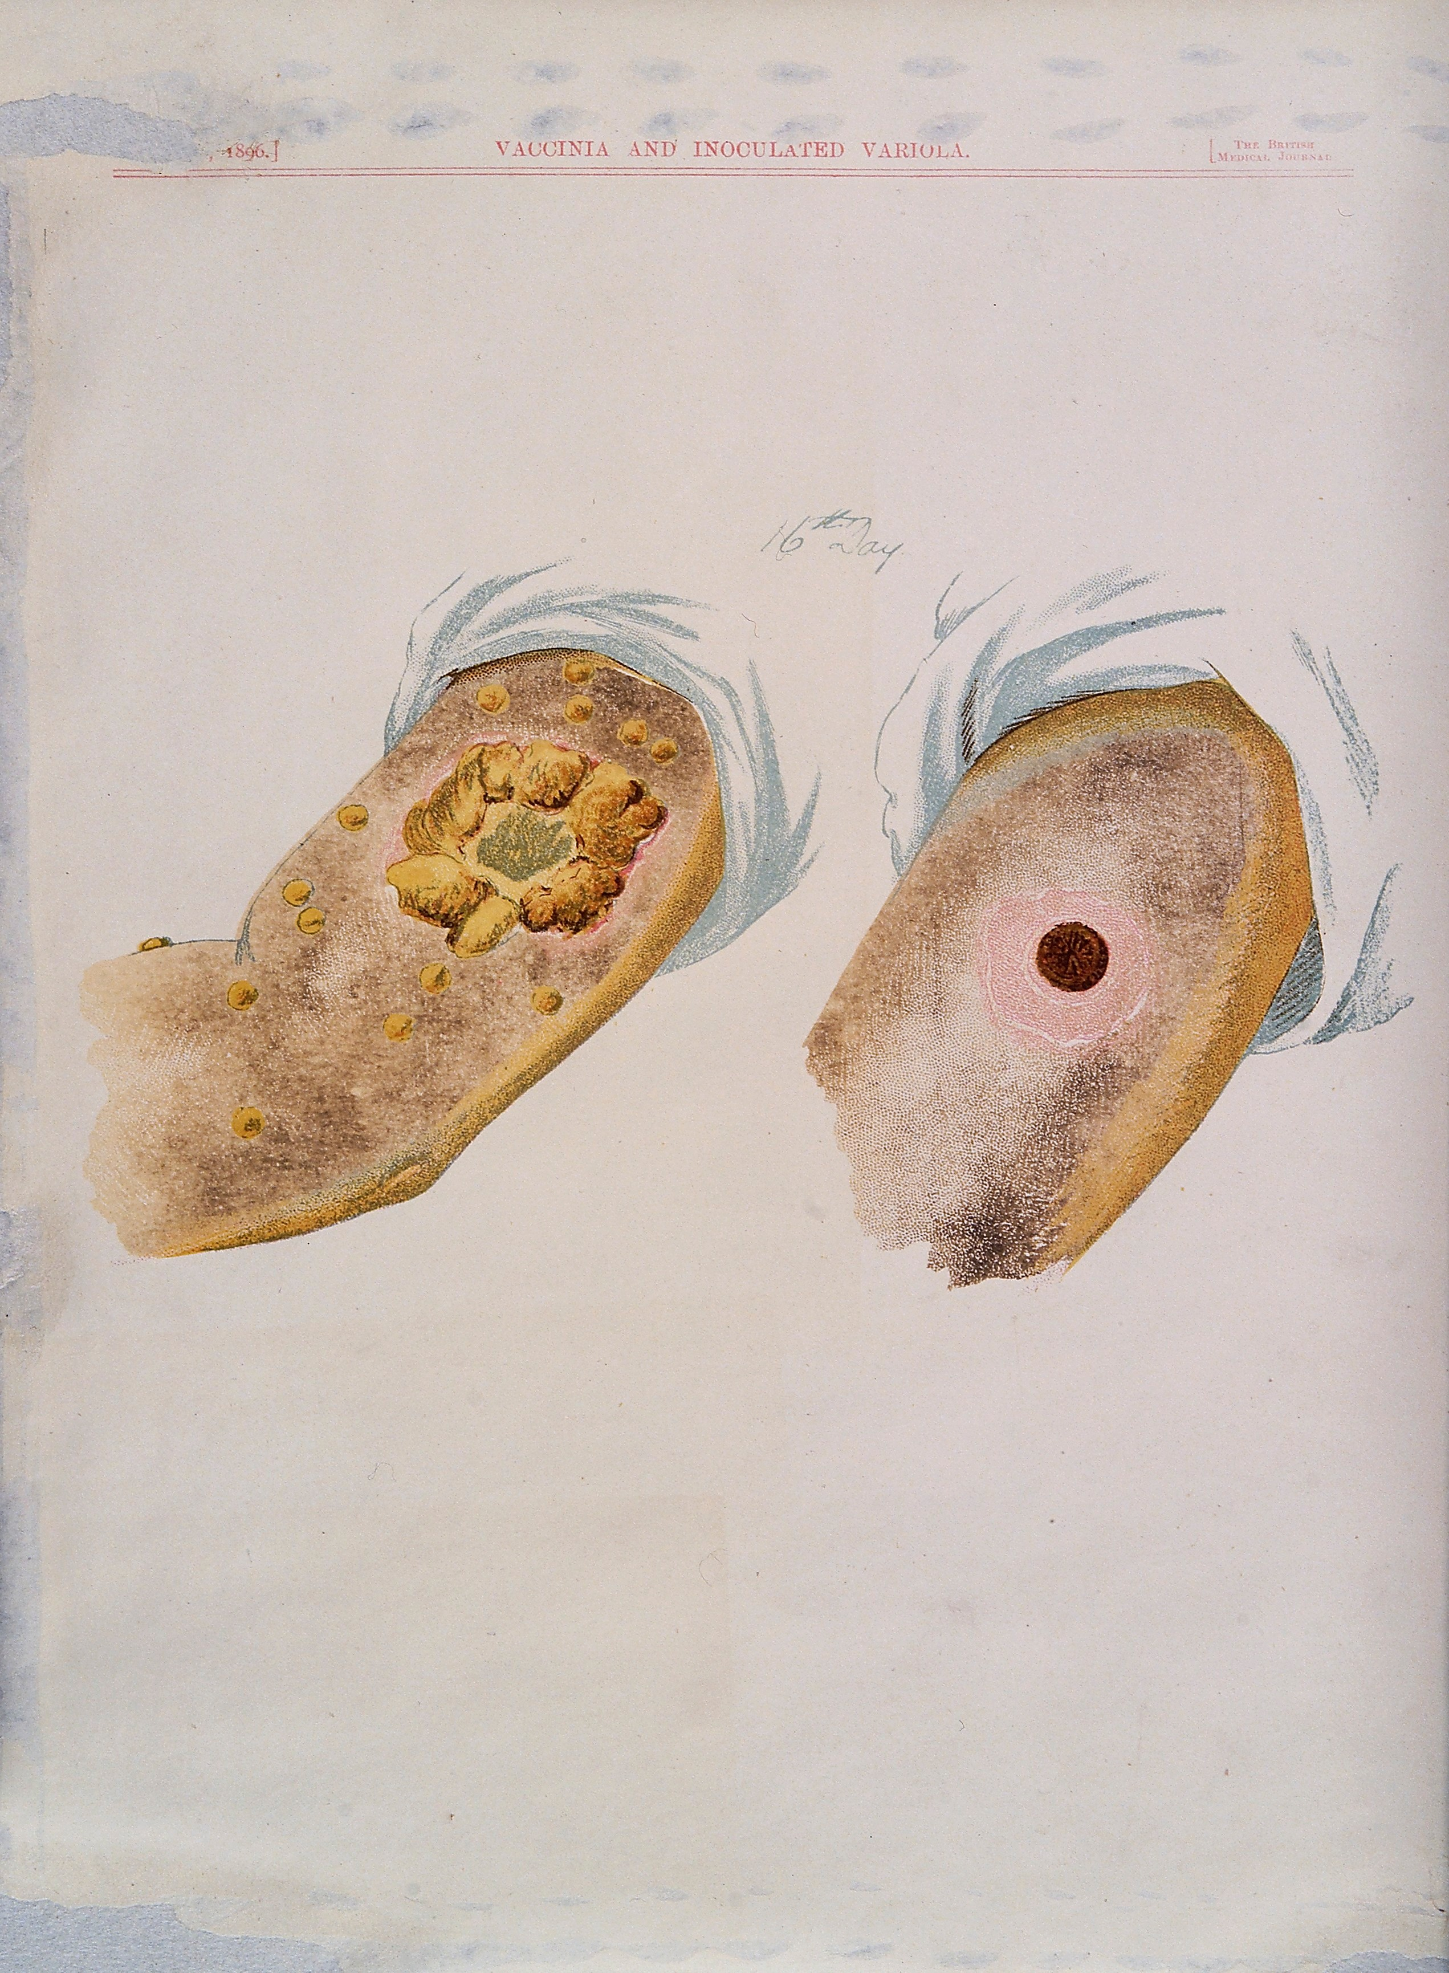
Cowpox Medical Illustration - Edward Jenner
Date of original: 1796
Material: Ink and paper
Object origin: United Kingdom
Reproduction: Yes
Preparation: Printed material
STATION “D”

Slide 9
Satirical Print – J. Gillray
After his 1796 experiments Edward Jenner began vaccinating patients against smallpox by using cowpox. This was met with mixed acceptance by the public. While Jenner struggled initially to convince patients, by 1800 the practice was spreading. However, not everyone had easy access to a vaccination. Some people could not afford the service, other did not live close enough to anyone who practiced vaccination and some even rejected the practice due to their religious beliefs. Even once the practice became mandatory for children in 1863, parents would refuse to register their newborns to avoid vaccinating them.

Slide 10
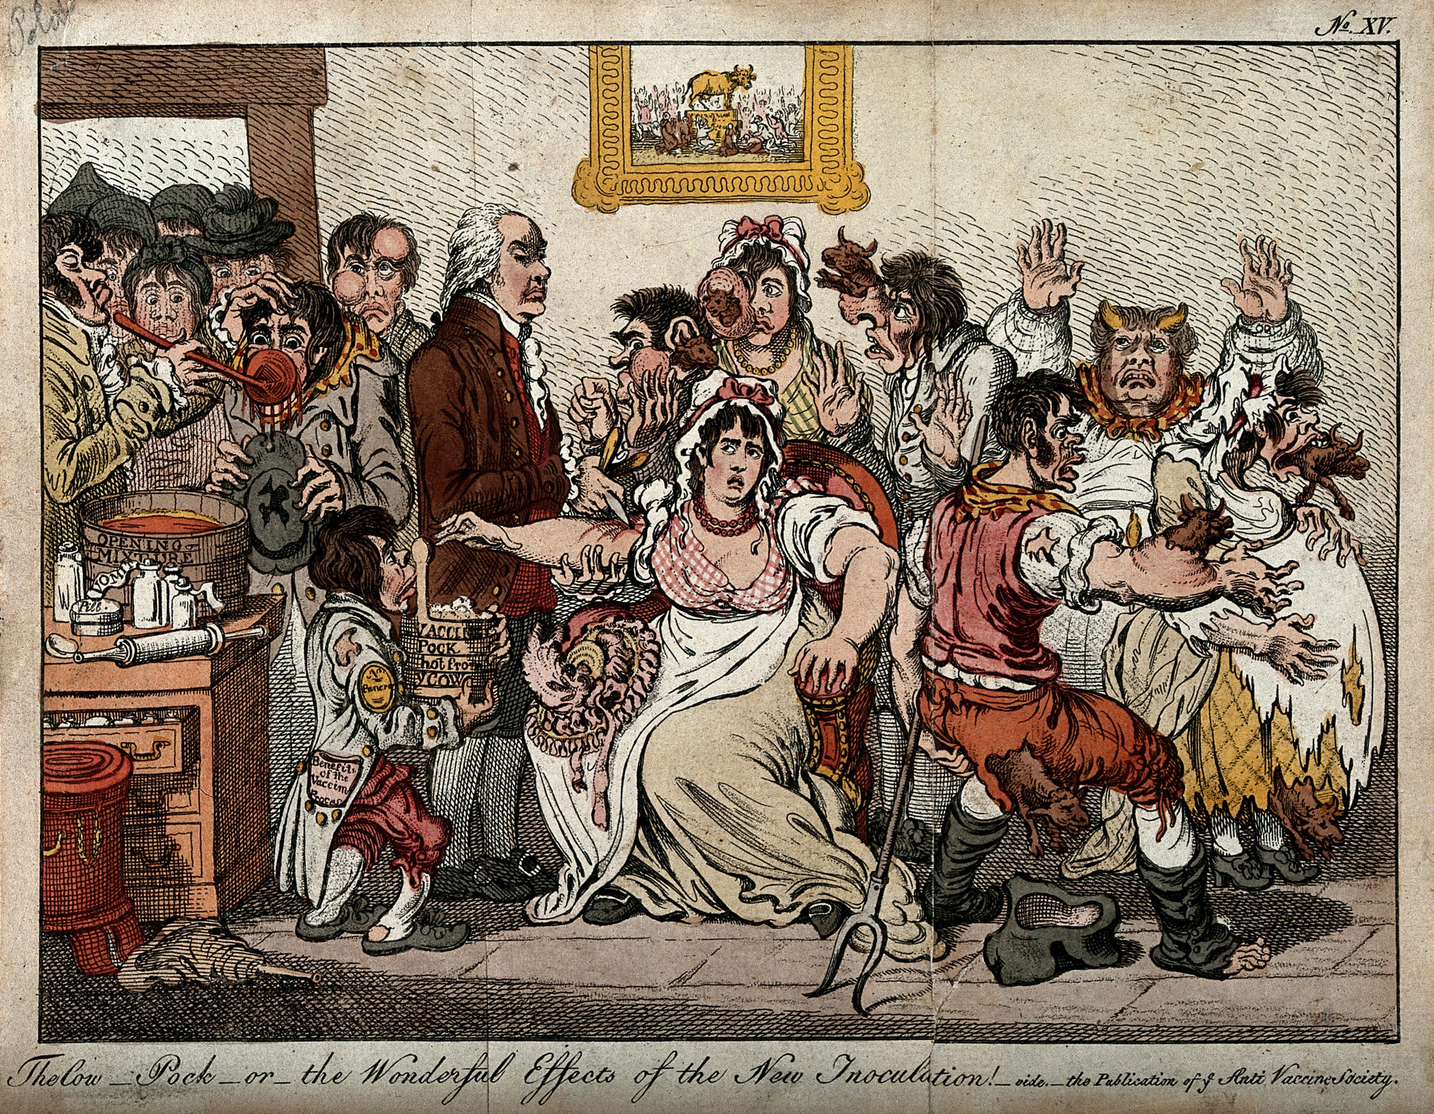
Satirical Print “The Wonderful Effects of the New Inoculation!” – J. Gillray
Date of original: 1802
Material: Ink and paper
Object origin: United Kingdom
Reproduction: Yes
Preparation: Printed material
STATION “D”

Slide 11
Smallpox Vaccine
By the 20th century smallpox vaccines were being manufactured globally. These later vaccines were administered from 2-pronged needles containing the vaccine. In 1980 smallpox became the first infectious disease to be officially eradicated by mankind. Vaccination is no longer mandatory, and the vaccine is not commonly administered.

Slide 12
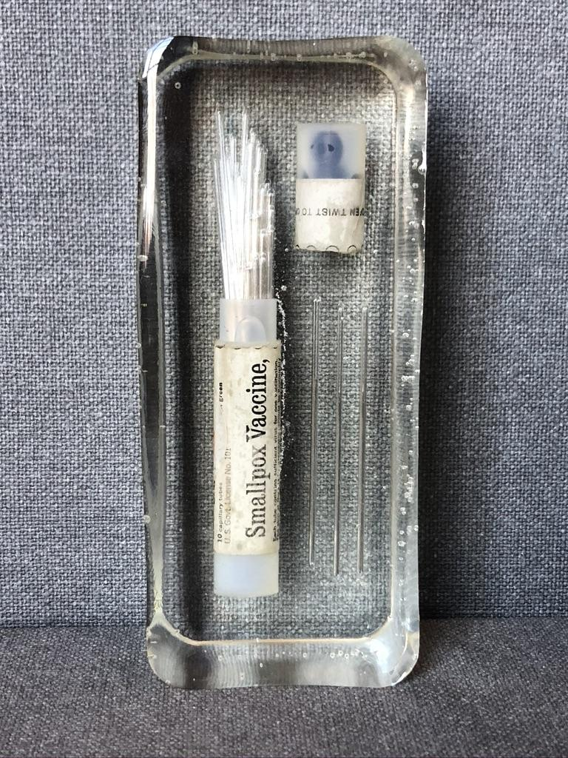
Smallpox Vaccine
Date: Unknown
Material: inactive smallpox vaccine, resin
Object origin: United States
Reproduction: No
Preparation: vaccine needle encased in
glass tube which is encased in resin
STATION “D”

